Slide 1

ASUA Webinar Series
FastPitch - Legal and Illegal Pitching

Slide 2
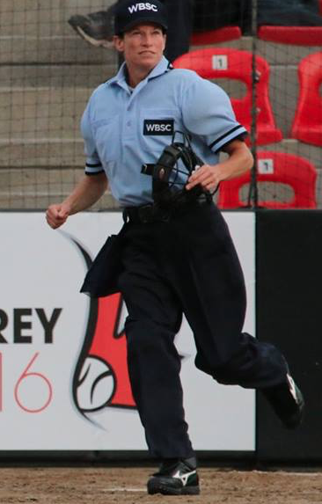
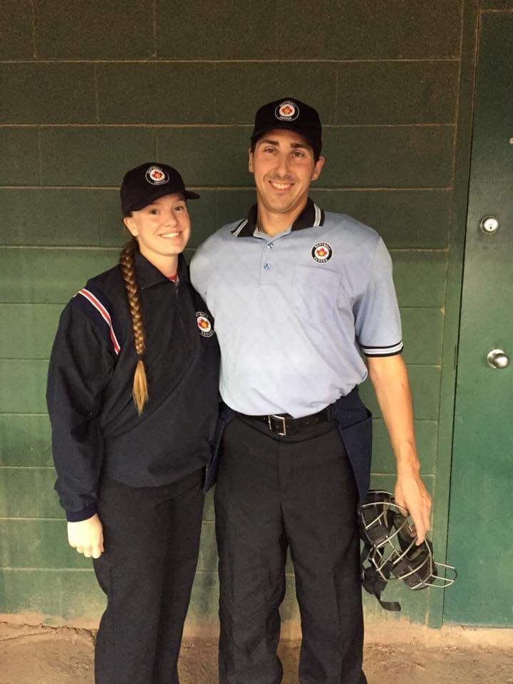
Meet ASUA’s Education Co-Chairs:
Frankie Billingsley
Kris Hartley
Softball Canada Level 4 Umpire (obtained in 2004)
Softball Canada Level 5 Umpire (obtained in 2011)
WBSC (ISF) Certified Umpire (obtained in 2013)

Slide 3
Agenda
Housekeeping
Fastpitch Rule
Illegal Pitch Mechanic
Penalty Enforcement
Mindset/Philosophy
Legal and Illegal Pitching examples
Point of Emphasis
Question & Answer Period
Notes:
30 minute session - 15 Q & A
Everyone is muted but, if you have a question - please enter the question into the Chat portion → to Organizers and we will answer the questions later in the

Slide 4

SOFTBALL CANADA Rulebook
PITCHING REGULATIONS
RULE 6 in the
Softball Canada Rulebook
Notes:
All of the following must take place for a pitch to be a legal pitch.
The pitcher must immediately deliver the ball to the batter upon making any motion to pitch.
The pitcher must only make one revolution on the windmill pitch. However, the pitcher may drop the pitching arm to the side and rear before starting the windmill motion. This allows the arm to legally pass the hip twice.
The delivery must be an underhand motion, with the hand below the hip, the wrist not further from the body than the elbow and with no stop or reversal of the forward motion.
The release of the ball and follow through of the hand and wrist must be forward and past the straight line of the body.
In the act of delivery the ball, the pitcher may take one step with the stepping (non-pivot foot) simultaneously with the release of the ball. The step must be forward towards the the batter and with the 24 inch length of pitcher’s plate. It is not a step if the pitcher slides either foot across the pitcher’s plate, provided contact is maintained with the plate, and there is no movement backwards off the plate.
The pivot foot must remain in contact with the pitcher’s plate or push off and drag away from the pitcher’s plate or be airborne prior to the stepping (non-pivot) foot touching the ground. The pitcher may leap from the pitcher’s plate, land and with a continuous motion deliver the ball to the batter. The pivot foot may follow through with the pitcher’s continuous action.
All movement of the pitching arm must be continuous as the pitcher steps, pushers or leaps from the pitcher’s plate.
The pitcher’s push off to drag, leap or hop must start from the pitcher’s plate. The pitcher must not crow hop or push off from any place other than the pitcher’s plate.
The pitcher;’s arm on the release of the ball may follow through, provided the wind-up does not continue.
The pitcher must deliver the ball to the batter so as not to deliberately drop, roll or bounce the ball to prevent the batter from hitting it.
The pitcher has 20 seconds to release the next pitch after receiving the ball or after the Umpire indicates “play”.

Slide 5
Umpire Responsibilities
PLATE UMPIRES
Take signal, or appear to take signal, with hands together.
Landing outside the 24 inch chute with the pivot foot (non-stepping foot)
Pause Violations
BASE UMPIRES
Responsible for Foot Violations
  Stepping Back,
  Stepping Forward,
  Rocking backwards (U16 & Above)
Leaping (U14 & below)

Slide 6

Illegal Pitch Mechanic
On 1st infraction -> Call “Time” and warn pitcher. Communicate with your partners reasoning for Warning (so all are aware).
*Note: Allow coach to come out and inform pitcher & coach what the warning is for.
On 2nd & Subsequent occurrence of same Infraction → As soon as you see the infraction, verbalize “Illegal Pitch” (loud enough for the nearest fielder to hear) raise your left arm at a 90 degree angle extended outwards at shoulder height with fist closed.
3) A warning is issued for each different infraction.

Slide 7
PENALTIES FOR ILLEGAL PITCH
When a Pitcher has committed an Illegal action, the penalty for an illegal is the following:
** It is Delayed Dead Ball situation** - Ball is live!
If the pitch is not hit, a ball is awarded to the batter & all runners advance 1 base.
NOTE: Runners are “protected” for 1 base from Time of Pitch. If they obtain more than 1 base on the illegal pitch, passed ball or wild throw by the catcher = Keep obtained bases.
If thrown out after the 1 protected base = Runner is out.

Slide 8
PENALTIES FOR ILLEGAL PITCH
2) If the illegal pitch is hit, the offensive manager has the option of taking:
a) the award of the illegal pitch (1 base award for all runners + ball on batter) OR
b) The result of the play - ie. A caught fly ball that scores a run.
EXCEPTION: If the batter becomes a runner due to dropped 3rd strike or hits the ball And all runners advance 1 base including batter. ⇒ Illegal Pitch is nullified! NO OPTION GIVEN.
3) When an illegal pitch hits the batter (hit by pitch) → Ball is dead. Batter awarded 1st and all runners advance 1 base. NO OPTION GIVEN in this situation.

Slide 9
MINDSET / PHILOSOPHY
Don’t look for the pitch to be ILLEGAL ,
⇒ Look for the pitch to be LEGAL.
  If it is not LEGAL = It has to be ILLEGAL
Examples:
The non-pivot foot must land on or within the 24 inch width (“In the Chute”)
The pivot foot must not bear weight again until ball is released.
*May or may not happen every pitch so umpires need to focus every pitch.
Notes:
Trends with illegal pitches tend to be on certain pitches such as change-ups….

Slide 10
GENERAL TIPS
When you are sweeping the rubber → take a quick glance down at the dirt in front of the rubber.
  If drag marks have a space/gap ⇒ pitcher is not dragging their foot/toe ⇒ Potential ILLEGAL PITCH.
If there is a hole (Trench) on the mound from the pitchers and the pitcher keeps their toe pointed downwards and foot is near ground level → It is not illegal.
IF YOU ARE NOT 100% sure → don’t call it! (“Bet your life” call)

Slide 11
U14 and below - Pitching
Pitchers at these categories need to step onto the rubber with hands separated.
They need to have 2 feet on the rubber and push and drag towards home plate.
New this year: They need to have a 2-5 second pause where their body is stopped entirely.
  (March 2019 Clarification from Jeff Whipple)
They Cannot leap, step back or step forward.
  MUST PUSH & DRAG!!

Slide 12
U16 and Above (Male & Female) - Pitching
The pivot foot (the non-stepping foot) must remain in contact with the pitcher’s plate prior to the start of the pitch.
  Lifting the pivot foot off the pitcher’s plate and returning it to the plate, creating a rocking motion = illegal act.
After taking the signal, the pitcher must bring their whole body to a full and complete stop with the ball in both hands in front or at the side of the body.
Pause = between 2 - 5 seconds. Pitchers must come to a complete stop during the pause. A “moving” pause is not legal.
The non-pivot foot (the stepping foot) must be stationary at the start and during the pause. The non-pivot foot can only move forward with the start of the pitch. Any backward movement of the non-pivot foot during or after the pause is an illegal action.
Pitchers can leap, land and throw in a continuous motion. The pitcher’s hands must be separated prior to landing.
Pitchers must continue to step directly towards home plate, with the stepping foot landing within the 24” length of the pitcher’s plate.
Summarize INFO FROM TECHNICAL BULLETIN!!

Slide 13
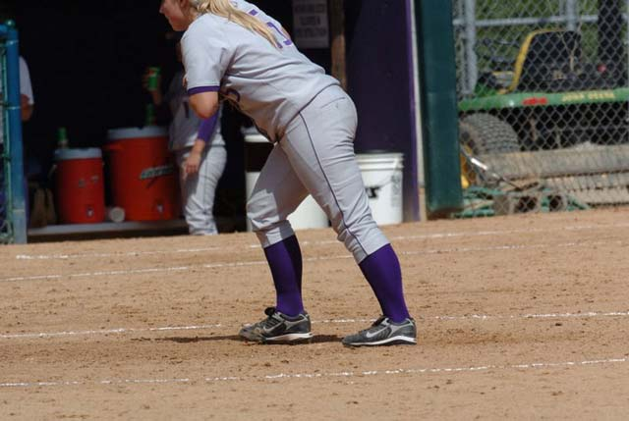
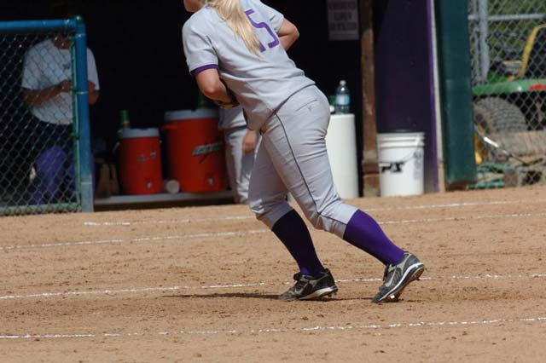
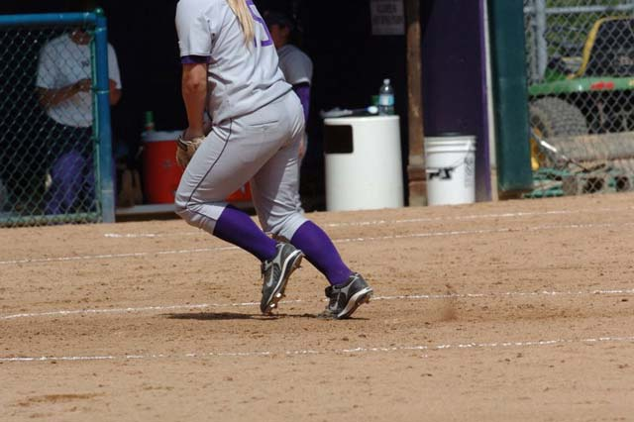
Legal Example (all levels)
Picture 1 Picture 2 PICTURE 3
Notes:
PICTURE #1: Good now
PICTURE #2: Still good
PICTURE #3: Still good

Slide 14
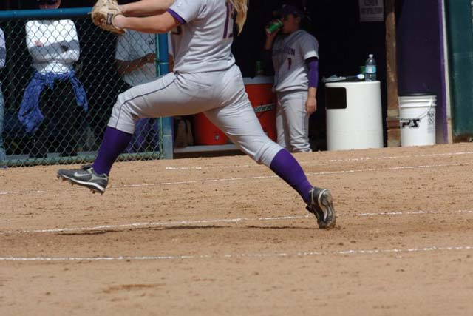
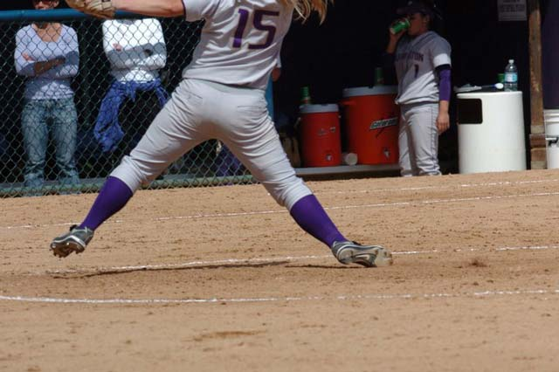
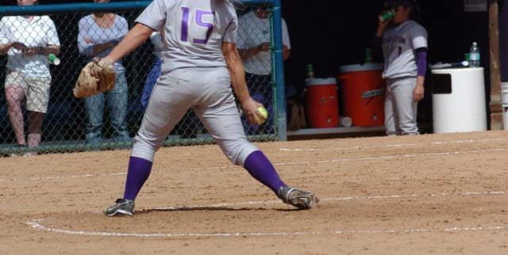
LEGAL - All categories
Picture 4 Picture 5 PICTURE 6
Notes:
PICTURE #4: Wow! Look at the big strong stride…and the pivot foot still on the ground.
PICTURE #5: No problem here except it looks like it might hurt her ankle
PICTURE #6: And she finishes just fine. LEGAL!

Slide 15
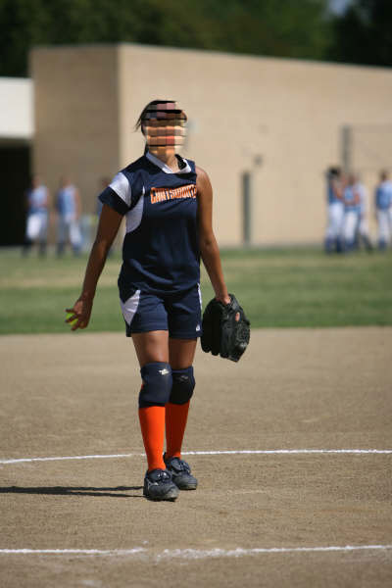
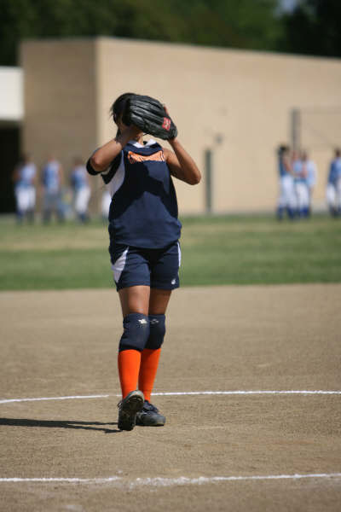
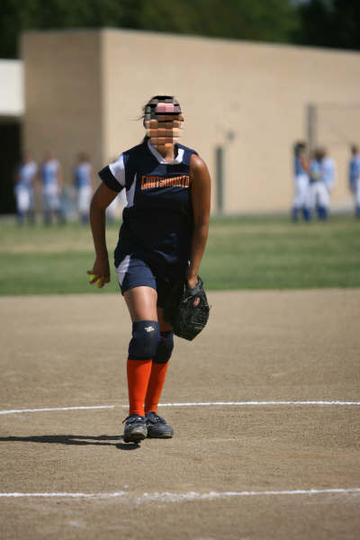
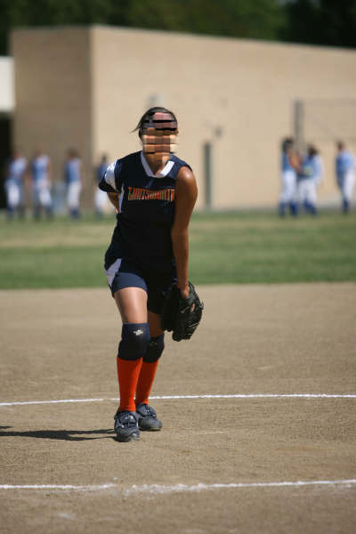
“LEGAL”
Picture 1 Picture 2 PICTURE 3 Picture 4
Notes:
PICTURE #1: Takes signal with hands apart.
PICTURE #2: Assume that she pauses for the required time here
PICTURE #3 & 4 = All good

Slide 16
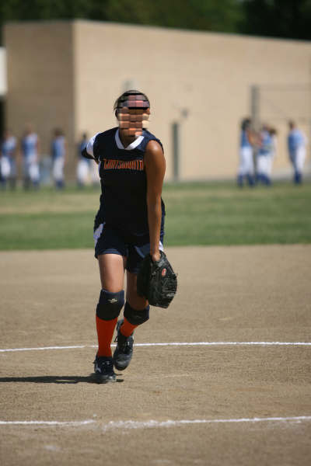
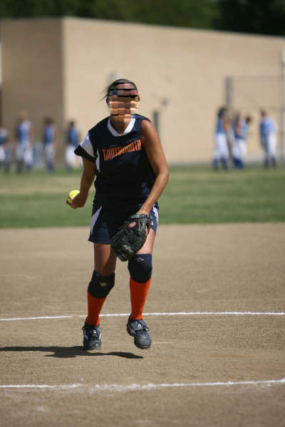
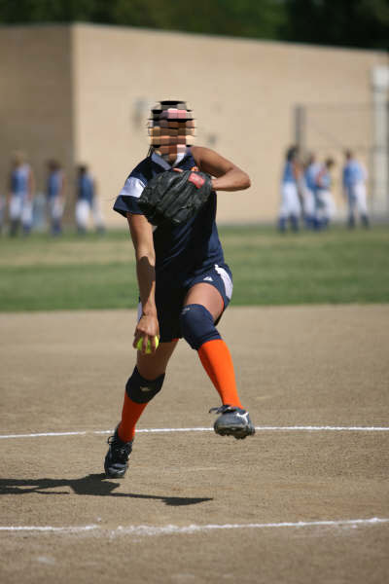
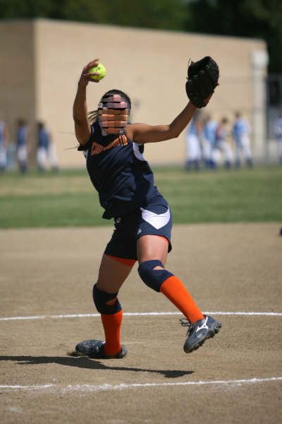
Legal Example - All categories
Picture 5 Picture 6 PICTURE 7 Picture 8
Notes:
PICTURE #6-8 → Keeps the pivot foot down and rotates her foot

Slide 17
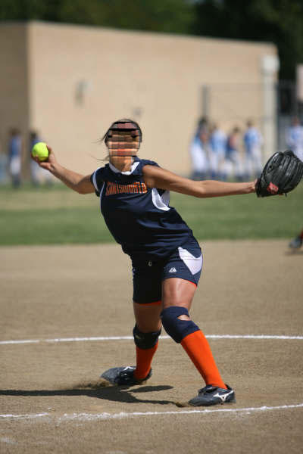
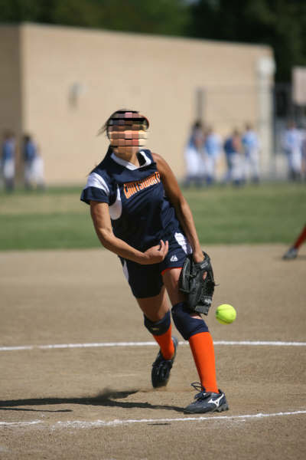
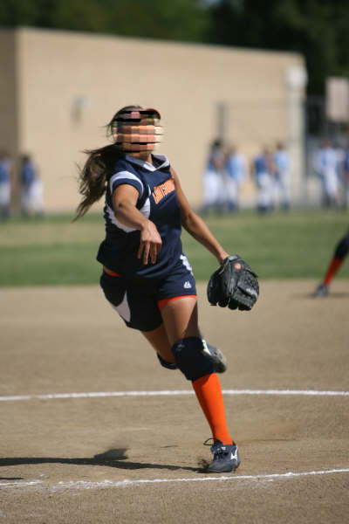
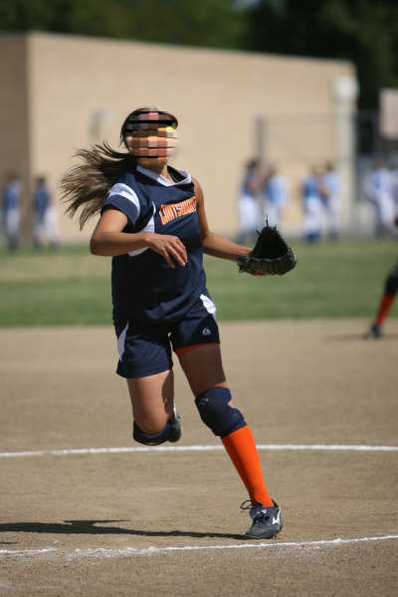
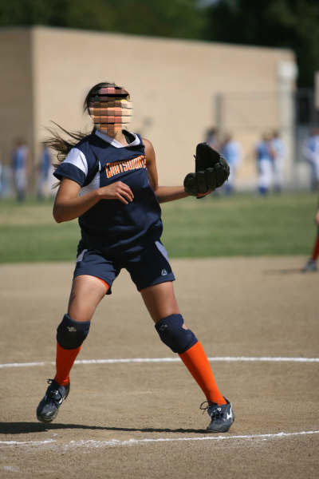
Legal
Picture 9 Picture 10 PICTURE 11 PICTURE 12 PICTURE 13
Notes:
LEGAL DELIVERY

Slide 18
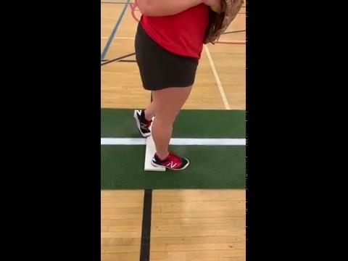
LEGAL PITCH
LEGAL
PITCH
PUSH
&
DRAG
Notes:
Here is a close up view of a pitcher pushing and dragging. → focus on front foot.

Slide 19
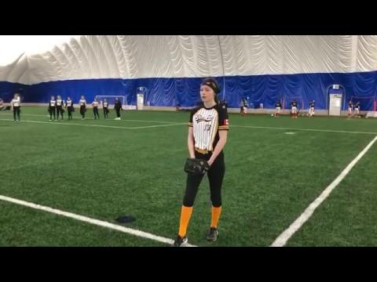
LEGAL DELIVERY - PUSH & DRAG

Slide 20
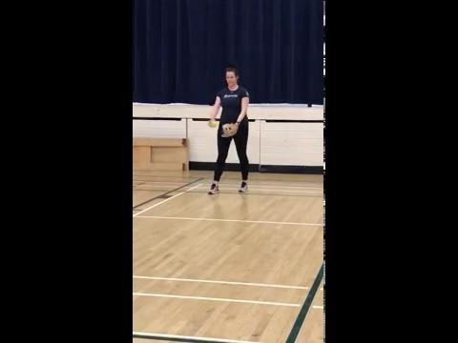
LEGAL
DELIVERY

Slide 21
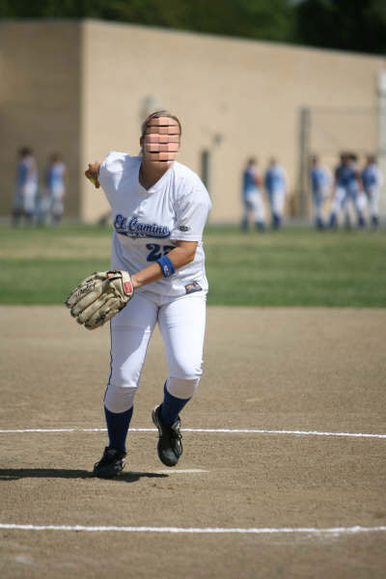
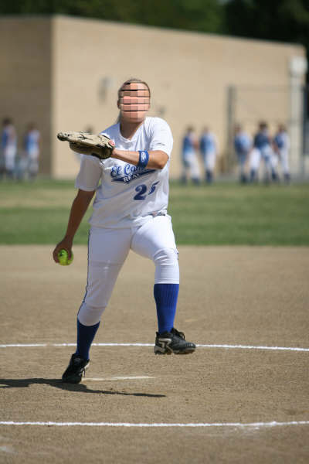
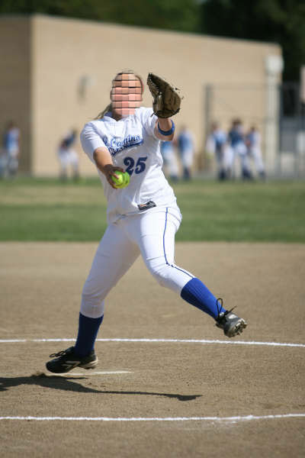
Illegal (U14 & Down) LEGAL (U16 & Up)
Picture 1 Picture 2 Picture 3
Notes:
PICTURE #1: So far so good.
PICTURE #2 : Still OK
PICTURE #3: Opps! I see air. Right here she is leaping. Notice that the pitching arm is just beginning to come up for the windmill revolution. Both feet are in the air.

Slide 22
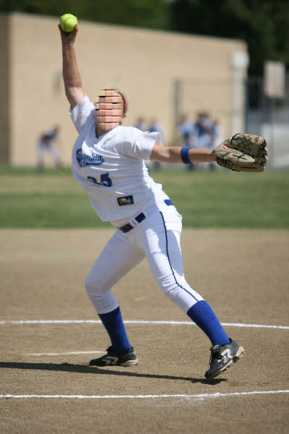
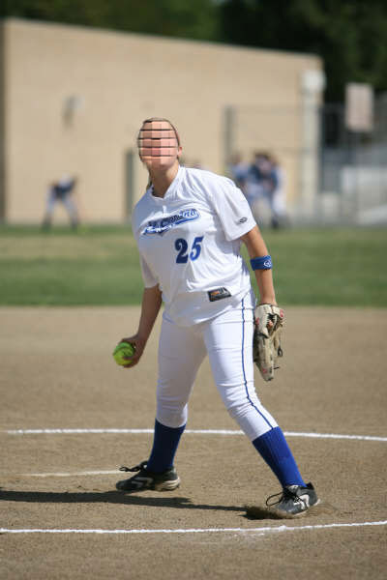
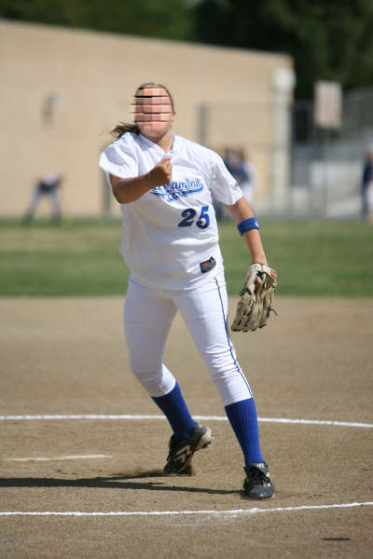
Illegal (U14 & Down) / Legal (U16 & Up)
Picture 4 Picture 5 Picture 6
Notes:
PICTURE #4: The pivot foot lands while the non pivot foot is in the air. The pivot foot is a considerable distance from the pitching plate. The arm is at the apex and is just beginning its downward thrust.
PICTURE #5: Finally the non pivot is on the ground. The arm has come down and no more impetus can be gained from the pivot foot.
PICTURE #6 The pitch is released as the pivot foot begins to follow through and drag away.

Slide 23
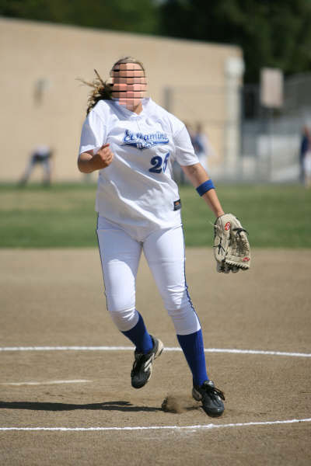
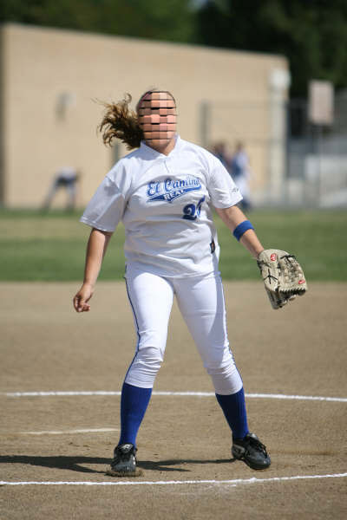
Illegal (U14 & Down) →LEGAL (U16 & Up)
Picture 7 Picture 8
Notes:
PICTURE #7: Some more Follow through.
PICTURE #8: And now she is ready to field the throw

Slide 24
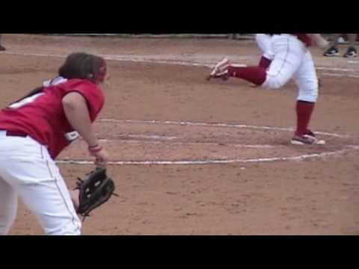
ILLEGAL → 24 Inch Violation
( “Out of the Chute” )
Notes:
3:31 → Out of the Chute

Slide 25
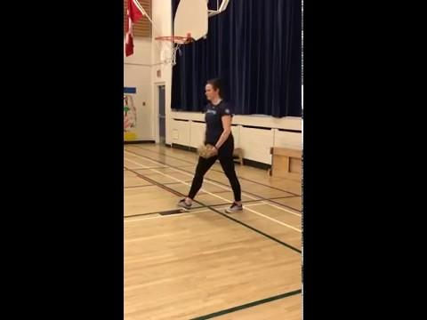
Stepping Forward
→ ILLEGAL in All Divisions)
Notes:
Video @ 2:36 → Video shows air = illegal but it is the step

Slide 26
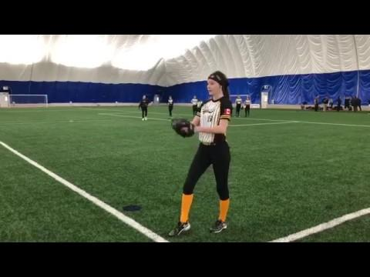
Stepping Forward

Slide 27
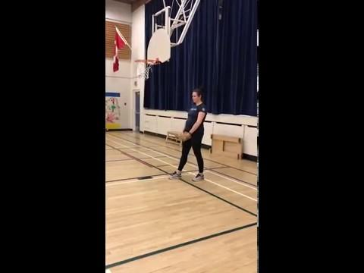
STEPPING BACKWARDS = ILLEGAL

Slide 28
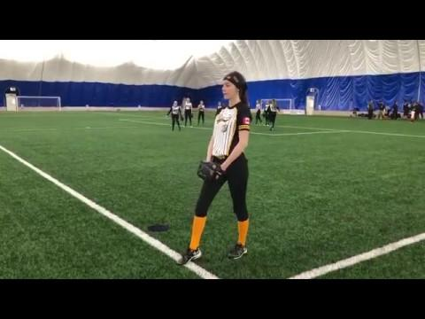
STEPPING BACKWARDS = ILLEGAL

Slide 29
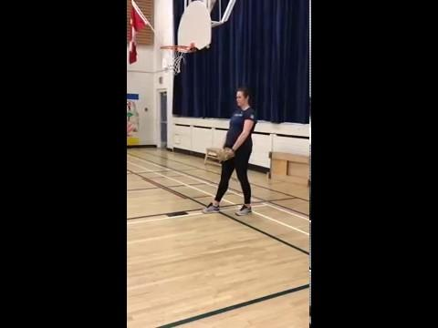
Rocking Motion = ILLEGAL

Slide 30
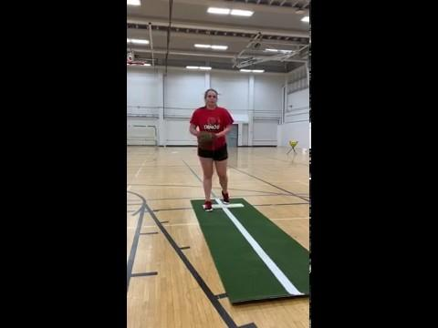
Illegal Pitch → NO 2 - 5 second PAUSE
(Rolling pause)

Slide 31
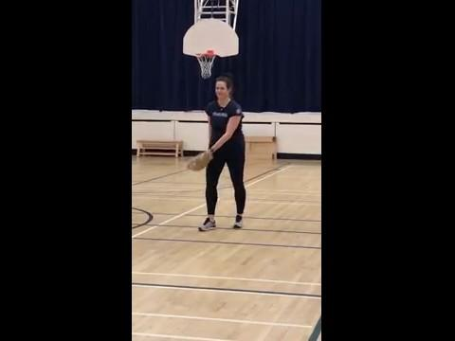
**NEW THIS YEAR** PAUSE (All Categories) = 2 - 5 seconds
2 to 5 second PAUSE
This is a
LEGALPitch

Slide 32
2 TO 5 SECOND PAUSE = LEGAL

Slide 33
LEGAL
PAUSE

Slide 34
Point of Emphasis 2019 Season
We need to work harder as an ASUA umpiring community to enforce the pitching regulations as stated in the rulebook.
As previously mentioned, this was observed at all levels (local to International) as an area that required a more consistent application of the rule across the board.
The biggest area of concern - the “pause”.
Please work with the pitchers and coaches - we do not want 30 illegal pitches called in a game. Not calling it does not do anyone any favors as many of these teams will play in postseason and when they travel to tournaments - it will be called! Help educate!!

Slide 35

Questions

Slide 36
THANKS
Haley Acton (U of C Dinos Fastball Pitcher)
Aydenne Brown (Youth Female Pitcher)
Chris Barber (Adult Female Pitcher)
Still Photos & videos from Cactus Umpires Association
Daryl Helmer and his company for the use of their “Go To Meeting” platform

Slide 37
Contact Information
Kris Hartley
Frankie Billingsley
(780) 904-4716 (587) 581-4450
Email: education@asua.ca

