Slide 1

Angles
And
Distance

Slide 2
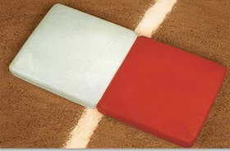
What is a good angle?
Where you keep all four elements in front of you
  Ball
  Base
  Offense
  Defense
Notes:
Umpires must hustle to get into the correct position with proper angle and distance to see the ball, the base, the runner and the fielder come together before making a call.

Slide 3

Force outs and Plays at 1B
90 degrees from the throw
No further than a 45º angle from the foul line at 1B
Notes:
Keep in mind that on plays at first we should let the ball turn our head into the play maintaining an angle that is 90 degrees from the throw and no further than 45 degrees from the foul line.

Slide 4
Tag Plays
Primary Position:
  90 degrees to the path of the runner
  Just short of the base they are trying to reach
Secondary Position:
  Move as necessary to get an unobstructed view of the play
  Best angle is 90 degrees to the tag
    This allows you to see thru the tag
Notes:
It may be necessary to adjust from the primary position to get the best unobstructed view of the play. This is achieved with the proper angle and distance, that will allow you to see between the offense and defense, WHILE keeping the four elements in front of us and letting the ball turn us into the play.

Slide 5
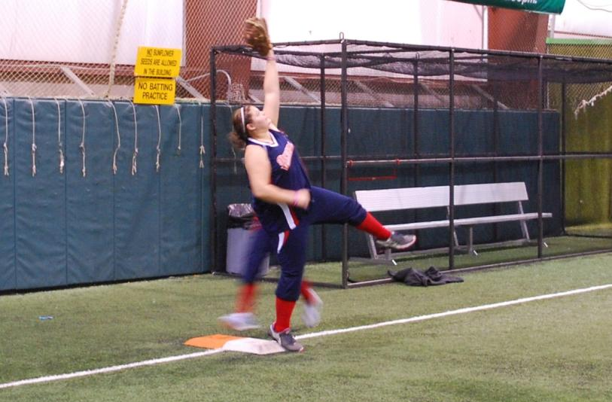
5’ 5” Player-7’ 8” Reach
12’ From the Play
Notes:
When focusing on the base from 12’ away you can not see the glove and ball within your primary viewing area (30 degrees from your line of sight) without shifting your eyes up to the glove.

Slide 6

5’ 5” Player-7’ 8” Reach
15’ From the Play
Notes:
From 15’ away you can see that only the edges are outside the primary viewing area and you can see both the feet and the glove within the primary viewing area. However, remember this is only a 5’ 5” player. Also remember that the closer all the information is to the line of sight, the better your ability to see it clearly (refer back to green vs yellow circle on slide 23).

Slide 7
5’ 5” Player-7’ 8” Reach
18’ From the Play
Notes:
At 18’ everything is well within the primary viewing area to allow you to process all information at once without having to shift your eyes from base to glove.

Slide 8
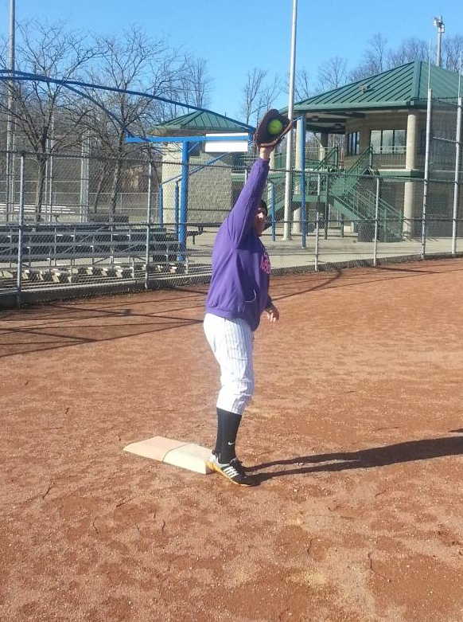
6’ 2” Player-10’ 1” Reach
12’ From the Play
Notes:
When focusing on the base from 12’ away you can not see the glove and ball within your primary viewing area (30 degrees from your line of sight) without shifting your eyes up to the glove.

Slide 9
6’ 2” Player-10’ 1” Reach
15’ From the Play
Notes:
When focusing on the base from 15’ away you can not see the glove and ball within your primary viewing area (30 degrees from your line of sight) without shifting your eyes up to the glove.

Slide 10
6’ 2” Player-10’ 1” Reach
18’ From the Play
Notes:
At 18’ everything is within the primary viewing area to allow you to process all information at once without having to shift your eyes from base to glove. But as a thinking umpire be ready to possibly move back based on taller players.

Slide 11
Helpful Hints for Proper Angle at 1B
Obtaining the proper angle at 1B
  As F3 sets up for a throw
  Their shoulders will be 90 degrees to the throw

Slide 12
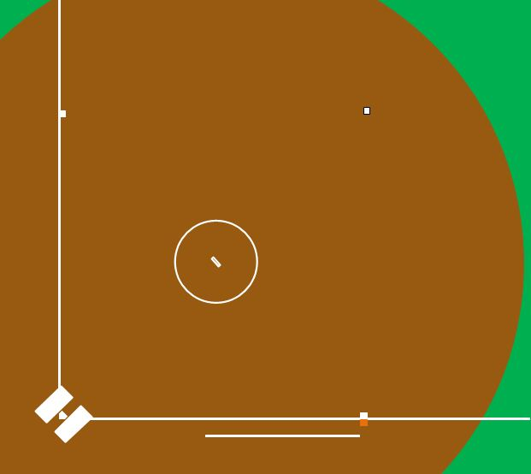
Visual to help Line up 90 degrees to the throw
Notes:
As ball is fielded by short stop F3 moves into position to accept throw which places F3’s shoulders (before the stretch) at 90 degrees to the throw.

Slide 13
Helpful Hints for Proper Angle at 1B
What is a 45 degree angle from 1B line?
  The front outside corner to the back inside corner of the white portion of 1B makes a 45 degree angle.

Slide 14
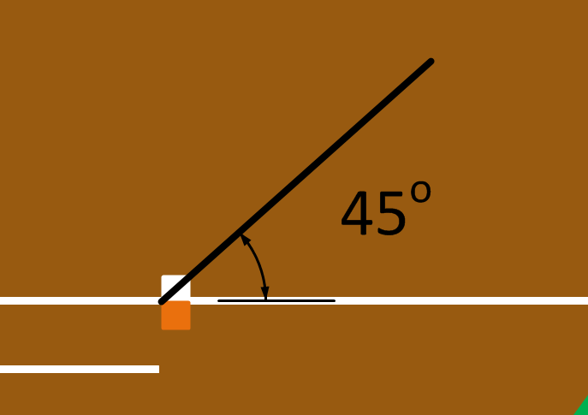
Visual of 45 degree angle at 1B

Slide 15
FAQ From Umpires
How do I maintain proper distance on a play at 1B?
  In 2 umpire Fast Pitch and 3 Umpire Systems
  Starting at 18’ from the base move in a line toward the back corner of 2B
Notes:
In both the 2 and 3 umpire systems when starting 21’ from 1B and walking the line, you should be at about 18’ when the ball is hit. From that point push off your left foot into the field and move along an imaginary line toward the back corner of 2B.

Slide 16
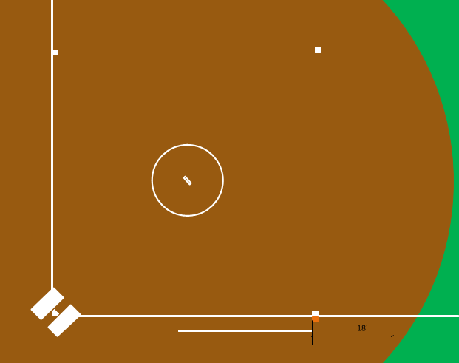
Guideline to keep proper depth
Notes:
Visual of moving along this imaginary line.

Slide 17
Plays at 1B

Slide 18
Throw from 2B
Distance from Base | Distance from starting Position | Steps into field
18 Feet | 3’ | 1-1.5 Steps
According to the American College of Sports Medicine
average human stride length is 31”
Notes:
Pushing off the left foot, move to a 90 degree angle from the throw. The black rectangle on the slide represents where the umpire pushed off with their left foot. The reference of 31” stride is an average and used to calculate number of steps in the following slides, actual steps will vary with individual umpire. We are NOT trying to have umpires count their steps every play, but this is a tool to help get them to the proper positions.

Slide 19
Throw from Short Stop Area
Distance from Base | Distance from starting Position | Steps into field
18’ | 8’ 10” | 3-3.5 Steps
Notes:
Showing a throw from short stop with proper position and distance both from the base as well as from the starting point in foul ground.

Slide 20
Throw From 3B Area
Distance from Base | Distance from starting Position | Steps into field
20’ | 15’ 5” | 6 Steps
Notes:
View of throw from 3B with proper position. Any ball thrown from within the red triangle area, the umpire would stop at a 45 degree angle from the foul line. This allows the best view of the play while giving the umpire the ability to move back to the foul line for a swipe tag if F3 is pulled off 1B by the throw. Think about how few times a slow pitch umpire should be at 45 degrees. Most plays in slow pitch the umpire should be at LESS than a 45 degree angle to the line.

Slide 21
Tag Plays

Slide 22
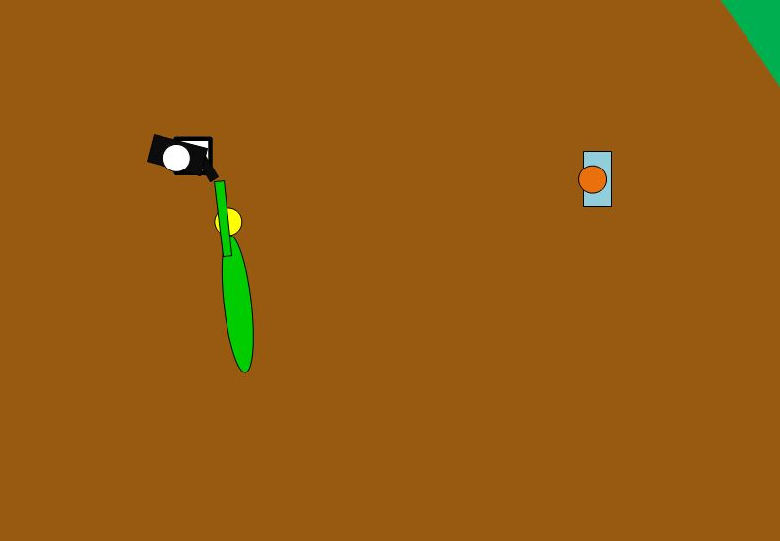
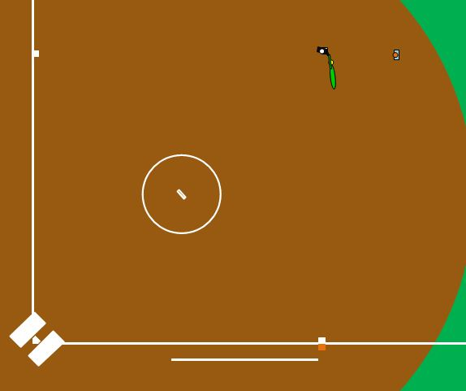
Steal at 2B
Notes:
Overview to show the angle on tag, followed by a close up view of the play. Notice the umpire is 90 degrees from the tag looking through the offense and defense.

Slide 23

Extra base hit to outfield
Primary Position
Notes:
A routine slide straight into 2B, the umpire should try to be at a 90 degree angle to the tag. NOT defaulting at a 45 degree to 2B.

Slide 24
Extra base hit to outfield
Adjust to Secondary Position
Notes:
This play has the runner attempting to reach the back side of the base. Point out the umpires movement to get an unobstructed view of the play while obtaining a 90 degree angle to the tag.

Slide 25
Views on throws from 3B
B
A
Notes:
Is where a lot of our umpires go, just one step off the line.
Is the position that we want our umpire to get, 90 degrees to the throw, no more that a 45 degree to the foul line.

Slide 26
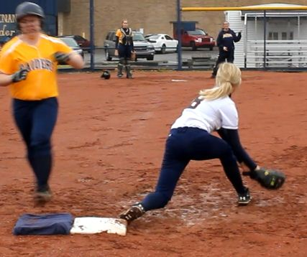
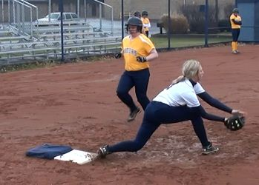
Throw from 3B
B
A
Notes:
Camera A shows the throw from 3B to 1B, umpire just one step off the line into the field.
Camera B is the same play but umpire comes off the line to a 90 degree angle with the throw AND NO MORE THAN a 45 degree angle with the foul line.
Notice the difference in what the umpire can see. Defensive player’s foot on the bag.

Slide 27
Throw from Short Stop,
F3 pulled off bag for tag
A
B
C
Notes:
Camera A is an umpire that has gone past 45 degrees to the line
Camera B is at 45 degrees
Camera C is view from where umpire adjusts as play develops into a tag play

Slide 28
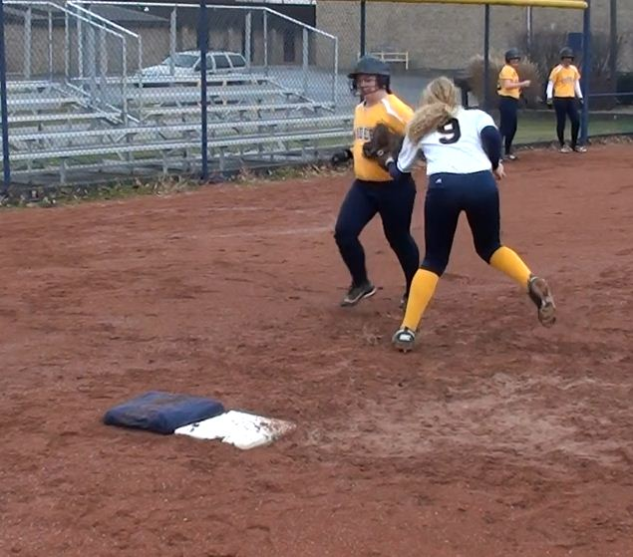
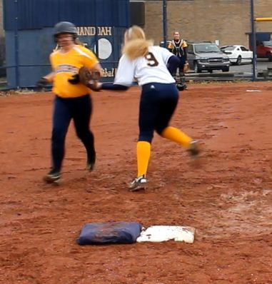
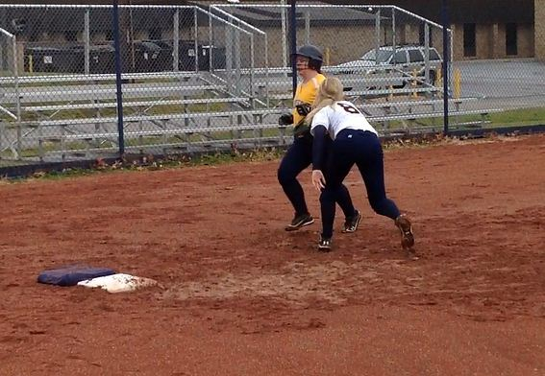
Tag at 1B
B
C
A
Notes:
Camera A is set up at a 70 degree angle from foul line with the base umpire moving closer to home to view the tag.
Camera B is set up is set up at a 45 degree angle of the foul line if fair territory, this is an umpire that moves to primary position and does NOT adjust for the tag play.
Camera C is set up with the umpire moving back to the foul line to look THROUGH THE TAG.

Slide 29
Views on throws from 2B
B
C
A
Notes:
Camera A is an umpire that went to foul ground for the play
Camera B is an umpire that defaulted to the 45 degree angle
Camera C is just across the foul line, 90 degrees to the throw

Slide 30
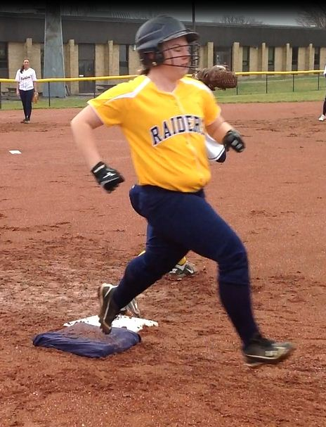
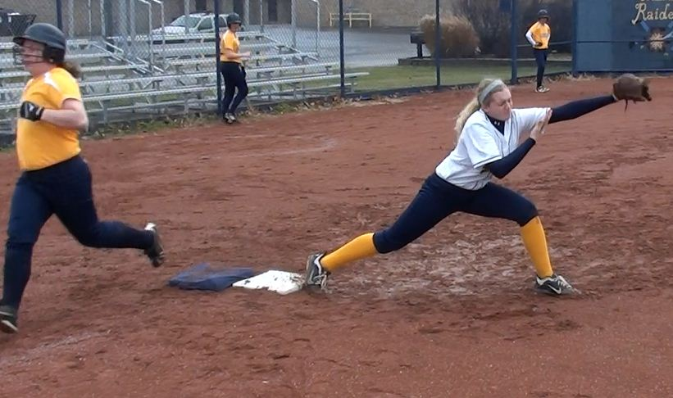
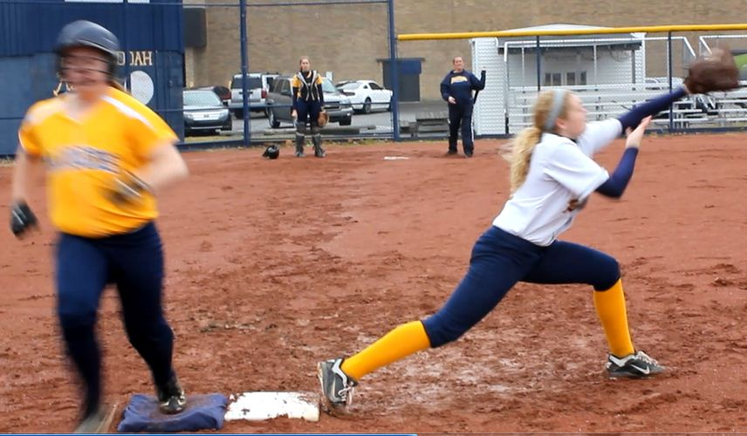
Throw from 2B
A
B
C
Notes:
Camera A set up at a 45 degree angle from foul line in foul territory. Notice the blocked view of the defensive player
Camera B is set up at a 45 degree view from the foul line in fair territory
Camera C is set up with a 90 degree angle of the throw from second base. Notice the pulled foot. We are not debating if you would call that or not, just showing the additional information available when 90 degrees to the throw.

Slide 31
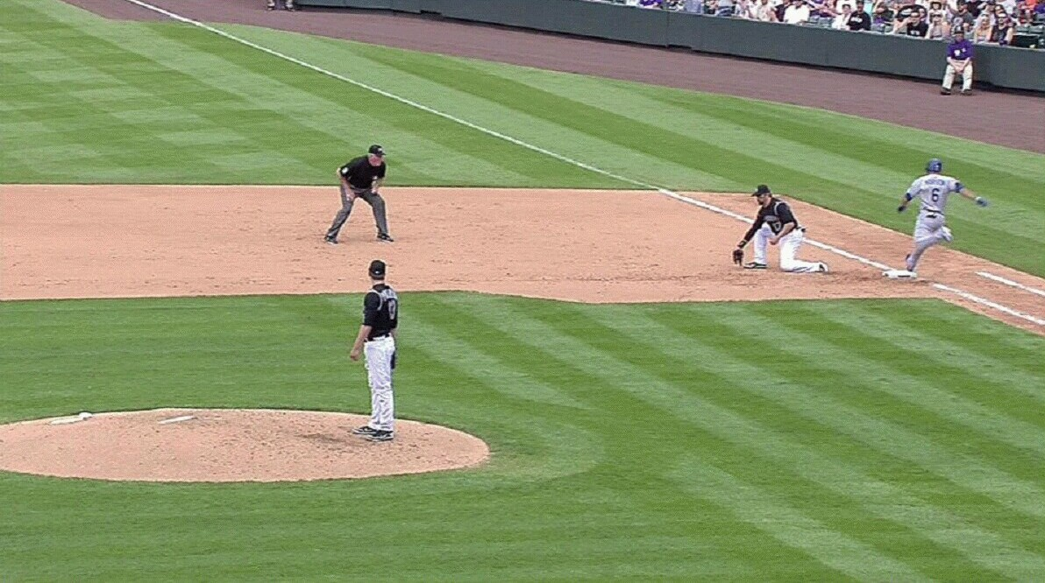
Throw From
Short Stop Area
Notes:
This was a Dodgers Rockies Game this past season. This umpire called the runner OUT. Red line shows where his line of sight is to the play. He can’t see the bag in this position.

Slide 32
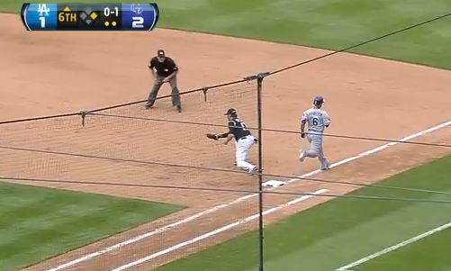



Throw From
Short Stop Area
Notes:
Red line shows what his line of sight would have been if he had moved to a 90 degree angle to the throw and no more than a 45 degrees from the line.

Slide 33
Views on Pickoff at 2B
B
A
Notes:
This is a 3 umpire system, with U1 starting counter rotated.
Camera A is the umpire that moves straight in
Camera B is the umpire that moves to a position to be 90 degree with the tag looking through offense and defense

Slide 34
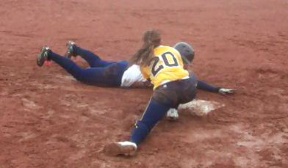
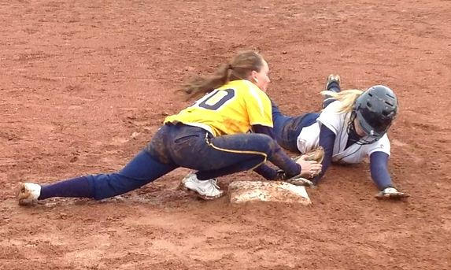
Pickoff at 2B
A
B
Notes:
Camera A is where an umpire comes straight into the infield to see the pick-off.
Camera B is where the umpire moves to look through the pick-off

Slide 35
Views on Pickoff at 3B
C
B
A
Notes:
First view is of a 2 umpire system.
Camera A shows base umpire not moving, or taking one step into the infield to view pickoff
Camera B shows base umpire that hustles toward the foul line to view pickoff looking through offense and defense
Clicking shows the 3 umpire system with U3 starting on the line.
Camera C shows that umpires view, taking one step in toward the play looking through the offense and defense (90 degrees to the tag)

Slide 36
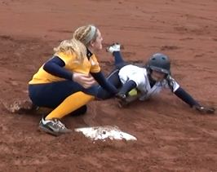
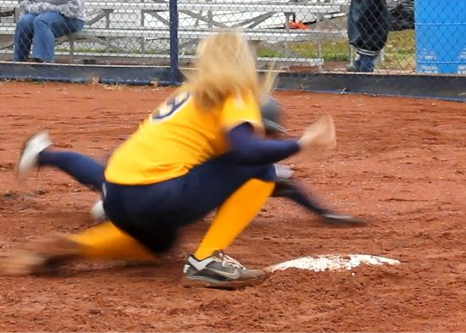
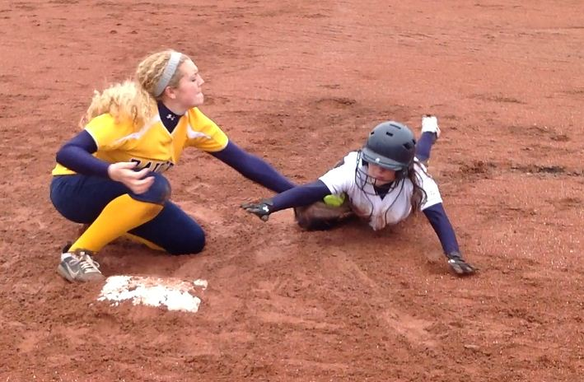
Pickoff at 3B
A
B
C
Notes:
Camera A in a Two Umpire System where the umpire doesn’t move to a secondary position to make the call.
Camera B is where we would want the umpire to move in a Two Umpire System.
Camera C is where the umpire would be in a Three Umpire System just stepping forward LOOKING THROUGH THE TAG.
NOT SHOWN: View of U3 going in foul territory (coaches box) to see play. This would be similar to the view shown from foul ground on slide 53 (Camera A)

Slide 37
Questions?

