Slide 1
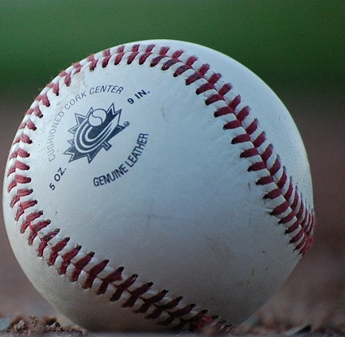
Umpire
Mentorship
A UNIFIED APPROACH

Slide 2
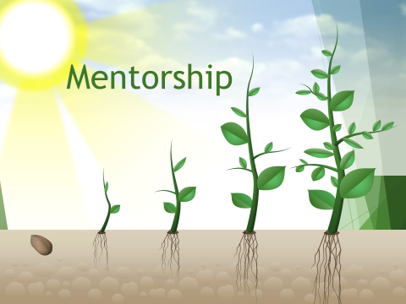

Slide 3
RESULTS…. 35 and under…survey says…..
Positive Experiences
Negative Experiences
- HAD FUN
- Someone
helped/supported me
- I felt successful
- I felt proud
- People were nice to me
- I understood what was expected of me
- I knew how to get better/improve
was embarrassed
felt like a failure
felt criticized
I didn’t understand what to do
nobody helped me/answered my questions
It wasn’t fun. I didn’t enjoy it.
Instructor didn’t care

Slide 4
RESULTS….over 35….survey says…..
Positive Experiences
Negative Experiences
- change
- felt encouraged
- felt supported
- felt challenged
- enjoyed seeing others succeed
- overcame my fear
Self growth
Created happy memories
Able to celebrate failure
don’t like unknowns
fear of failure
I was criticized
I was mocked
was not supported
afraid of injury
Don’t like confrontation
Lack of appreciation
No positive reinforcement
egos

Slide 5
What did we learn about young people???
We better make sure that…
We CANNOT…
They have FUN (our culture)
They have a clear understanding of what is expected of them (identified competencies)
They are encouraged and supported (philosophy)
We validate their effort and celebrate their successes (acknowledgement)
They know we care about them and they feel safe (relationships)
Allow them to be openly criticized and demeaned without interventions in place
Allow them to continue umpiring poorly for their entire career
Allow “intention-behaviour” gaps to exist

Slide 6
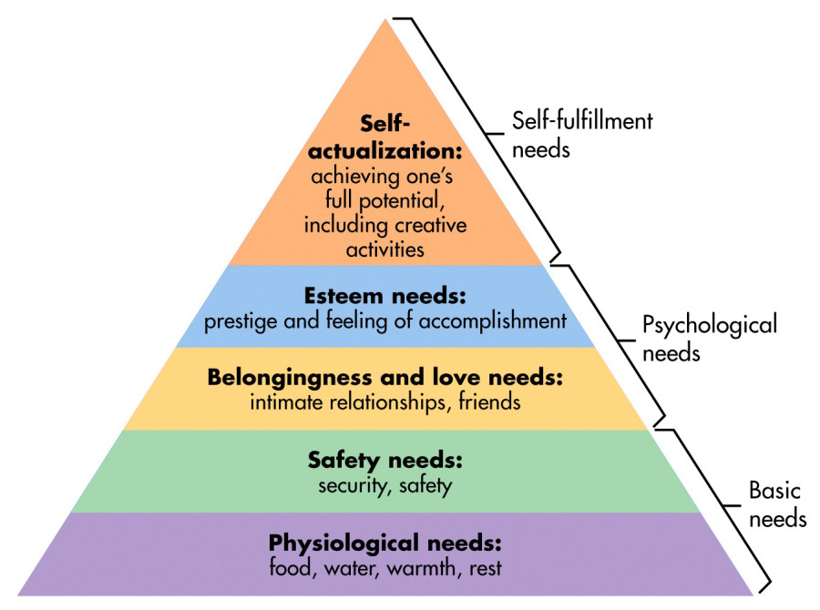



Maslow’s Hierarchy of Needs
Growth happens

Slide 7
US National Association of Sport Officials Survey article from 2017
17,500 officials surveyed from multiple sports
8/10 officials quit after 2nd year
Of those who quit – 75% of them indicate ADULT BEHAVIOUR as the reason
47% of officials indicated they had felt “unsafe” or “feared for their safety” from players, coaches or spectators
On average, it takes 6 years for an official to be prepared to officiate varsity level sports
In 1962 the average age of an official was 18,In 2017…..it was 53
74% of officials recommended mentorship as a retention strategy for new officials
HOW WILL WE KEEP DEVELOPING YOUNGER OFFICIALS IN THE GAME?

Slide 8
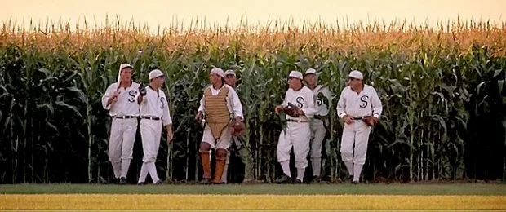
IF we build it….they will come…

Slide 9
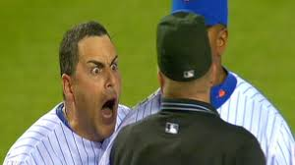
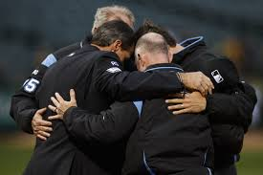
IF….
THEN….
….we believe that criticism, abuse and lack of support leads umpires to become discouraged, feel incompetent and quit….despite the fact that they love the game….
….if we create an environment of safety, care and development opportunities, umpires will grow, become competent and confident and stay for the love of the game…

Slide 10
If Baseball Canada (NSO)….
Endorses and promotes the development of MENTORSHIP programs at the provincial level
The Provincial (PSO) organizations will
*establish a framework and options for delivery
*define standards and competencies
*work within the sport to ensure ZERO tolerance for umpire abuse
*incentivize local associations
The local (LSO) associations will
*identify mentors
*mentors will receive approved provincial training
*identify best model of delivery
*track and monitor progress at this level
New Umpires will
* Have a safe place to learn and develop
*receive ongoing feedback after their pre-season clinic
*be connected to more experienced umpires
*will have FUN, experience success and STAY
*Provide resources, ongoing support and monitoring
Theory of Action

Slide 11
CULTURE….what is it?
Definition: The social behaviors and norms of a particular group of people.
What are the CULTURAL NORMS in sport that our officials are experiencing right now?
Let’s look at some headlines….

Slide 12

Verbal and Physical Abuse of Game Officials and Poor Sportsmanship Cause of Shortage: A crime in 22 states to assault referee
Football referees: death threats, physical violence and verbal abuse are all part of the job
Parents Behaving Badly: A Youth Sports Crisis Caught on Video
Blame the stripes: The rampant abuse in sports officiating
Watch: Stemming the Abuse of Youth Sports Officials
Verbal Abuse, Violence Driving Umpires/Referees Out of Sports
Verbal abuse from parents, coaches is causing a referee shortage in youth sports
The Law Doesn't Always Protect Referees
Referee abuse drives high turnover rate among junior sports officials
The Nationwide Decline in Sports Officials
-

Slide 13
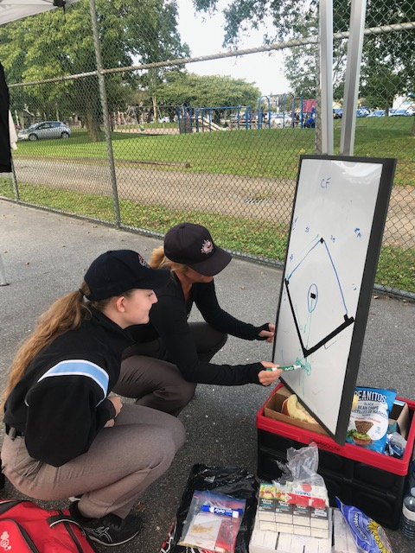
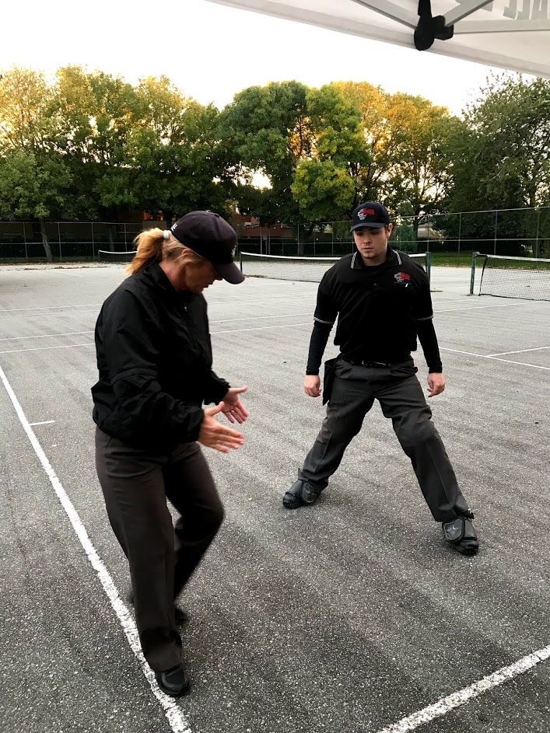
We need to CHANGE the current CULTURE….

Slide 14
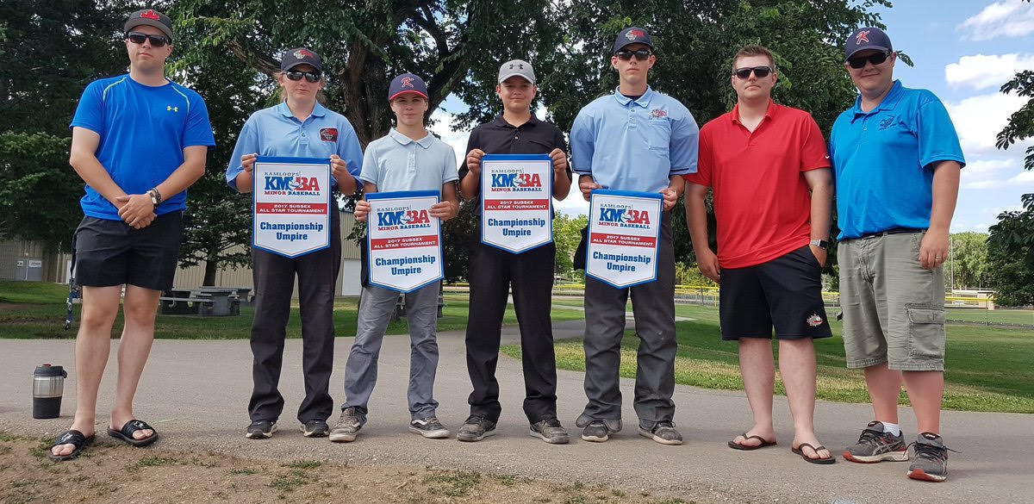
Having a mentor:
gives a new umpire a SAFE place to learn
gives support when they don’t know a rule or how to handle a situation
gives the opportunity to SEE SOMEONE DEMONSTRATE how to do something correctly
means a new umpire gets IMMEDIATE feedback so he/she can do it right the next time (or try)
makes them feel valued – someone is interested in MY DEVELOPMENT

Slide 15
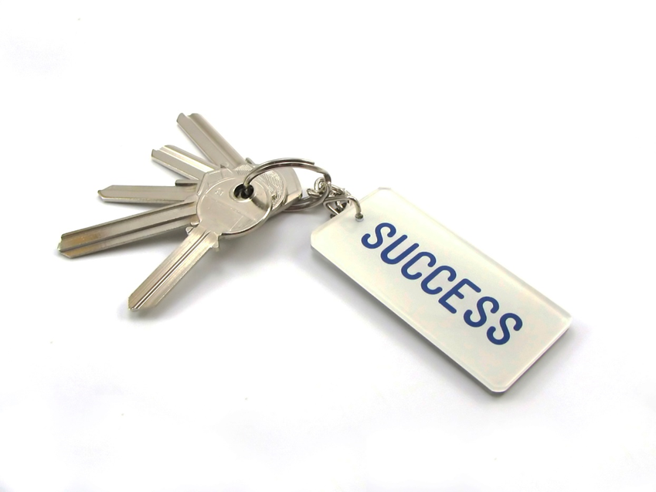
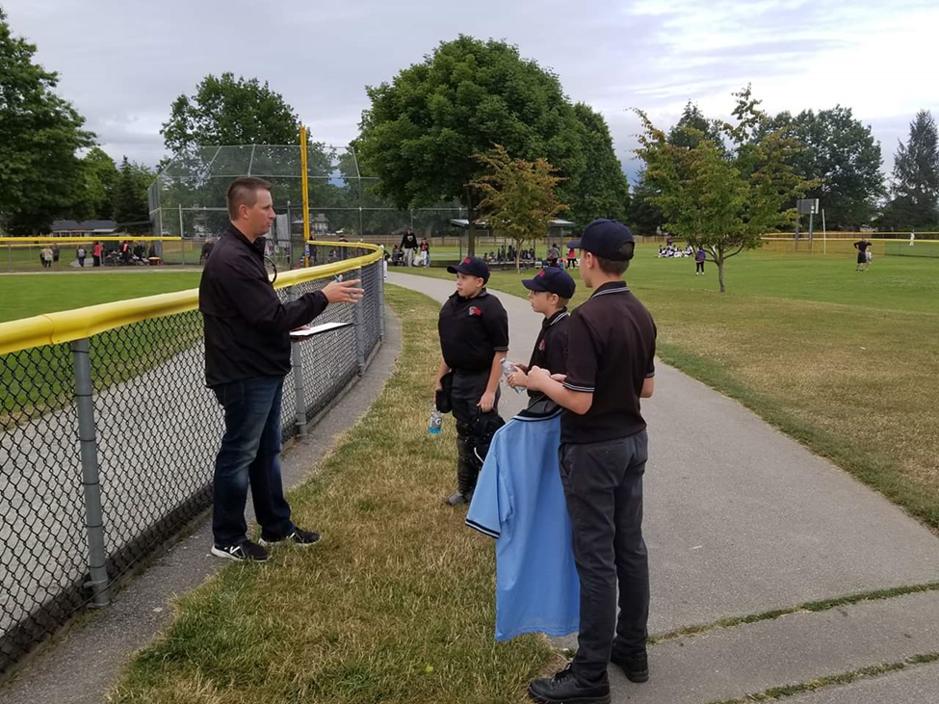
THE KEYS…
To be an effective mentor….
1) Know your skill development plan
2) Be an excellent model
3) ALWAYS be positive/encouraging
4) Give specific in-game feedback
5) Summarize the learning post game
6) Set objectives for your Mentee’s next game

Slide 16
Mentorship is “coaching feedback” not EVALUATION
Evaluation is a SUMMATIVE term – used to “assess” or determine a qualification. Pass/Fail…or in our world EMERGING or EFFECTIVE
Coaching feedback is a FORMATIVE term – used to identify where an individual is currently and recommends specific changes in order to move them to where they need to go.
Mentorship is NOT evaluative in nature. Mentors are NOT evaluators.
Coaching feedback is a practice that sustains continual growth and development that builds on each acquired skill.
Coaching feedback builds relationship by focusing on strengths, acknowledging achievements and setting targets for continual improvement.

Slide 17
Benefits for the Provincial Program
Develop a culture of personal and professional growth
Share desired behaviours and attitudes
Enhance leadership and “coaching feedback” skills in midlevel and senior umpires
Improve morale, performance and motivation
Engages, retains and develops umpires
Creates an OPTIC for coaches, players, parents and fans

Slide 18
Benefits for local association:
mentoring is a way to develop emerging talent
keeps knowledgeable and experienced umpires engaged and energized.
transferral of basic knowledge and skills
mentoring creates a CULURE of support. A TRIBE for officials. A sense of belonging
Many mentees return to mentor others because it was such a life line for them

Slide 19
HOW DO WE DO THIS?
The Provincial body:
Provides incentives
Defines the pedagogy of skill development
Provides training for the Mentors
Supports the associations with leadership for implementation
The Local body:
Identifies CHAMPIONS who will lead implementation
Identifies potential Mentors to be trained
Identifies the program that fits their unique needs and works with the PSO/Umpire Committee to implement

Slide 20
WHAT WE KNOW…
Educational research tells us that “coaching feedback” is one of the most effective ways to immediately improve performance
There is much evidence, both anecdotal and analytical that this process improves both performance and retention.
Mentorship benefits everyone: The Mentor, the Mentee, the local Association, and the Parent Organization
Mentorship is succession planning – it ensures that umpires stay with the game long enough to become competent.
Mentorship turns useless criticism into positive learning opportunities.

Slide 21
Changing mindsets…changes culture
….FROM
TO…….
Every umpire for herself
This kid is truly terrible
Passively listening to others criticize
Being entertained by others failures
“I am past working low level ball”
We are a team
We have some work to do
Asking them what can be done to improve
Taking responsibility for their improvement
“I am a resource for others”

Slide 22
IF you build it….a change in culture will come…
Investment of TIME leads to relationship.
Relationship leads to TRUST.
Trust leads to SAFETY.
Safety leads to learning.
When we can learn in a safe environment, we gain confidence and we improve. When we are successful we feel proud and we are motivated to continue. It becomes FUN

Slide 23

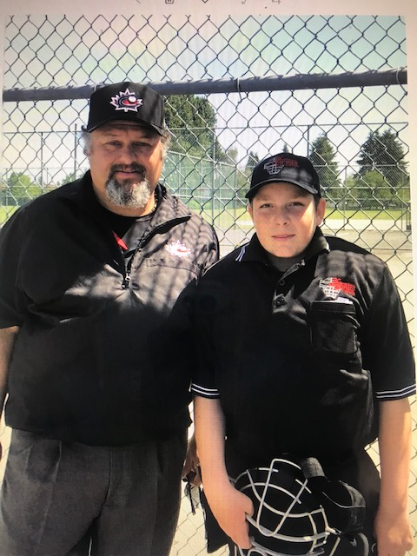
Mentorship

Slide 24
CONTACT INFO:
Rhonda Pauls president@bcbua.ca ladyblue.uic@gmail.com c.604-217-7640

