Slide 1
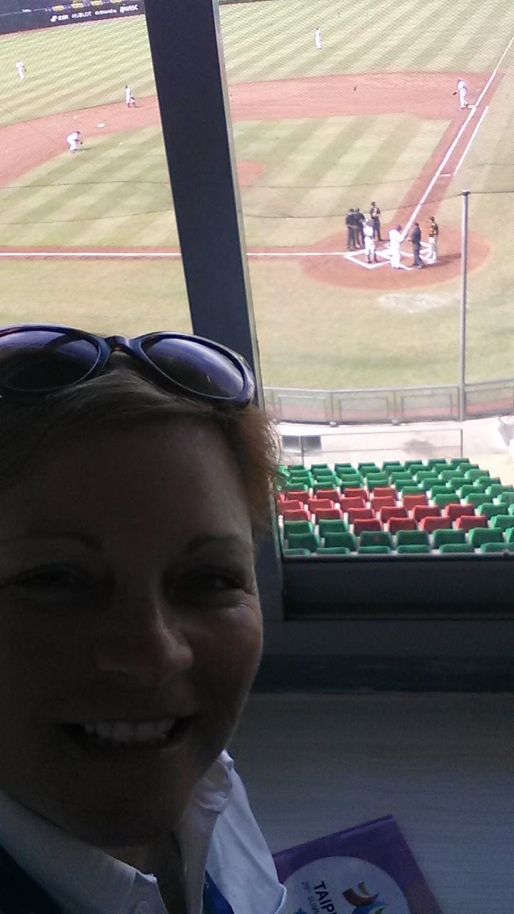
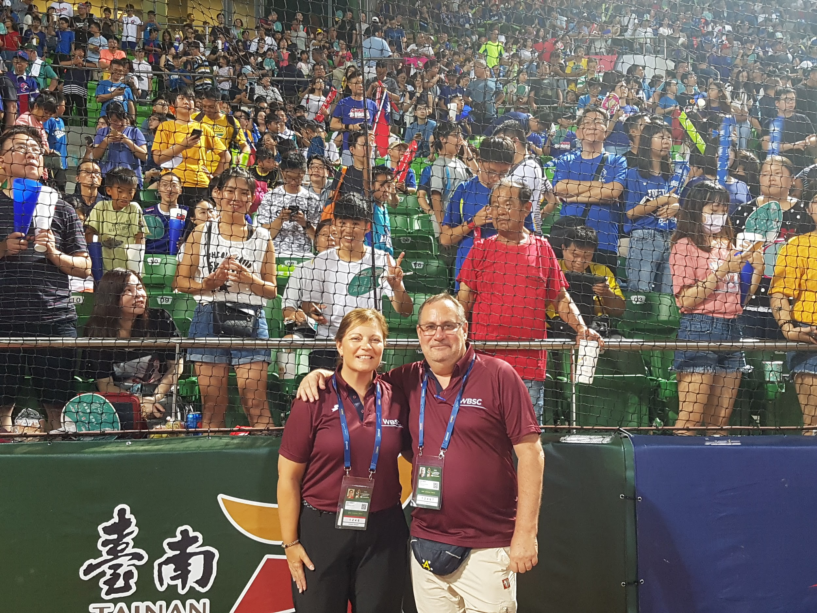
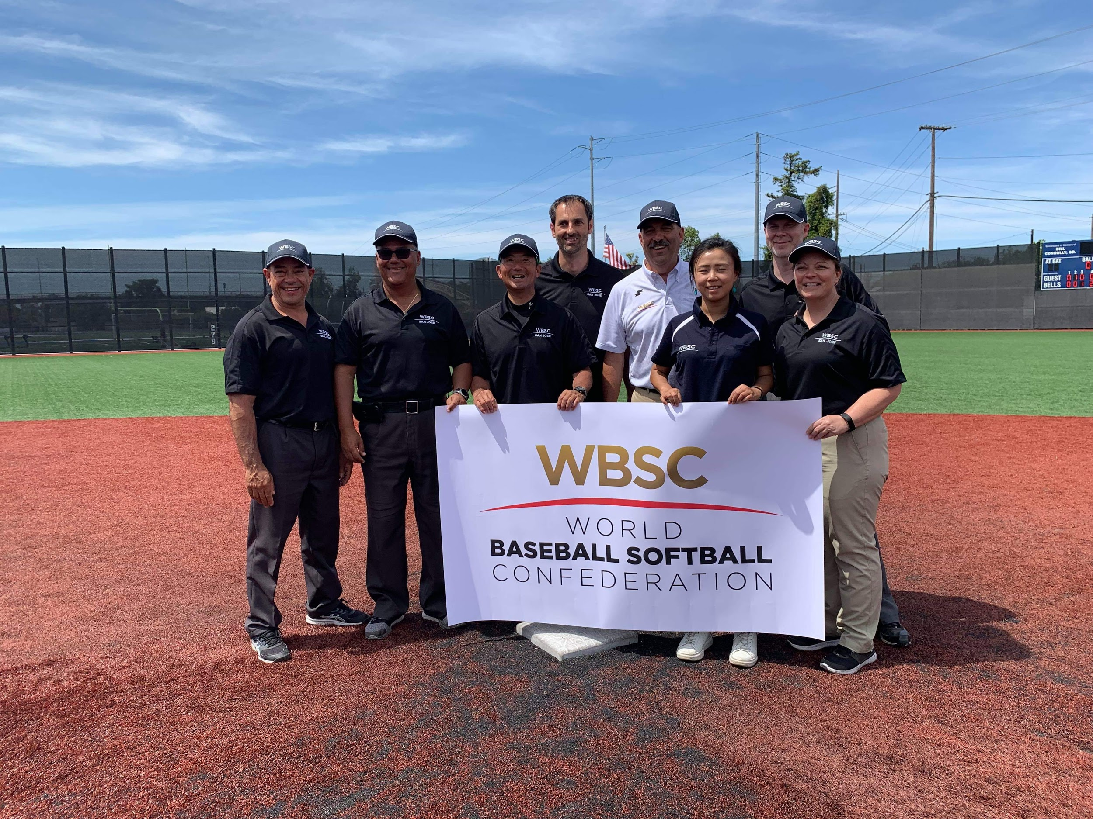
An Evaluator’s Perspective
Sharing knowledge and experience from an evaluator’s perspective, providing tips and and strategies on giving evaluations and for umpires receiving evaluations. Insight for umpires to self-analyze their own officiating, set goals and take advantage of resources and opportunities available.

Slide 2


Slide 3
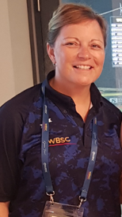
Lisa Turbitt – WBSC, Baseball Canada, Baseball Ontario
•WBSC Baseball Umpiring Commission
•2020 WBC Qualifier: Umpire
•2019 WBSC Clinic – San Jose, California: Instructor
•2019 – WBSC Umpire Director: U12
•2018 – WBSC Umpire Director: U15
•2017 – WBSC Umpire Director: University Games
•2016 – WBSC Umpire Director: Women’s World Cup
•2004/2006/2012 – Umpire: Women’s World Cup
•Baseball Canada Master Course Conductor
•Baseball Canada National Championships: Umpire/Supervisor

Slide 4
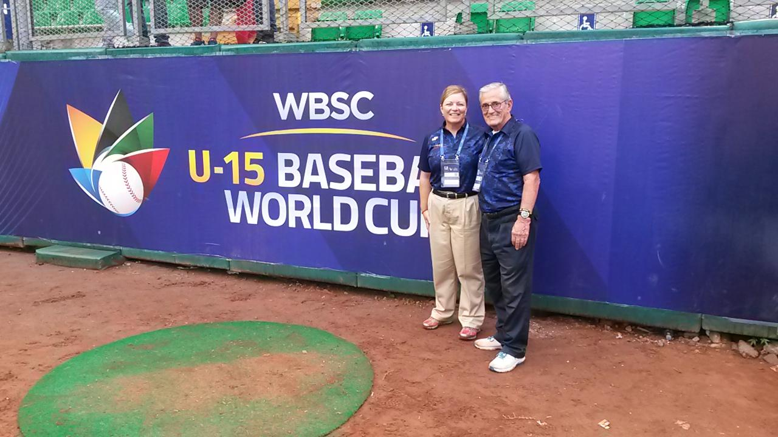

Slide 5
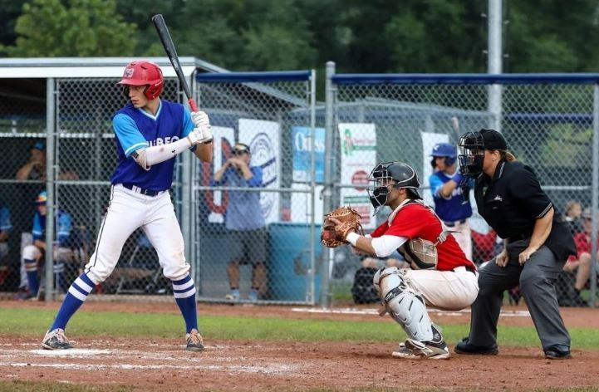
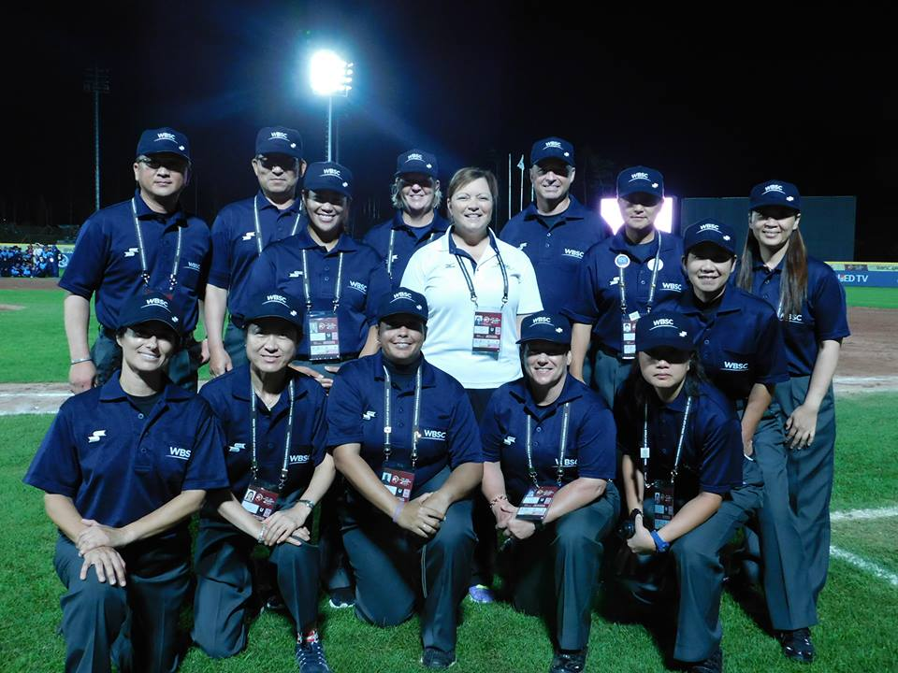
S – C – L
          SELF
          Self Reflection/Analysis
          Goal Setting
          Accessing Resources
COLLEAGUES
Work with a Mentors/Colleagues
Watch/Observe others
Ask questions, learn from their experience
LEADERS
Supervisors
Evaluators
Umpire Directors

Slide 6

Umpire

Slide 7
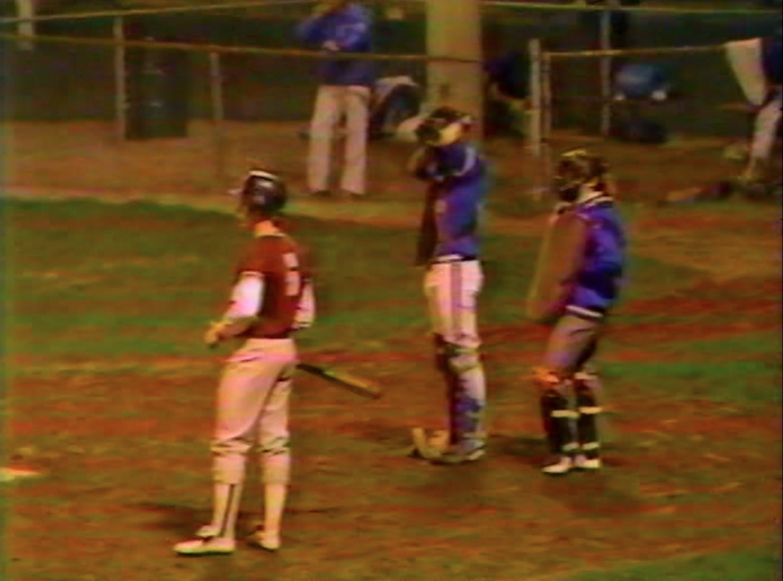
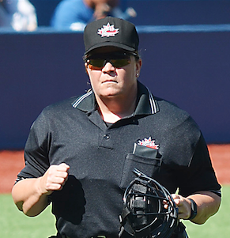
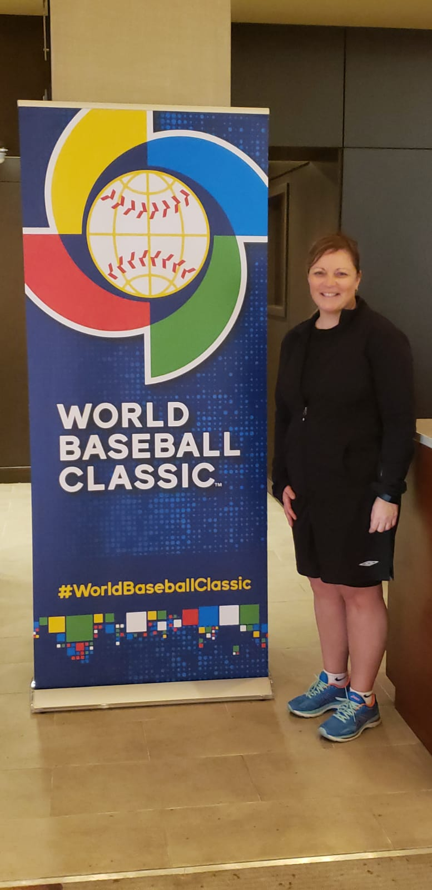
SELF – Analysis, Reflection and Goal Setting
Dream Big

Slide 8
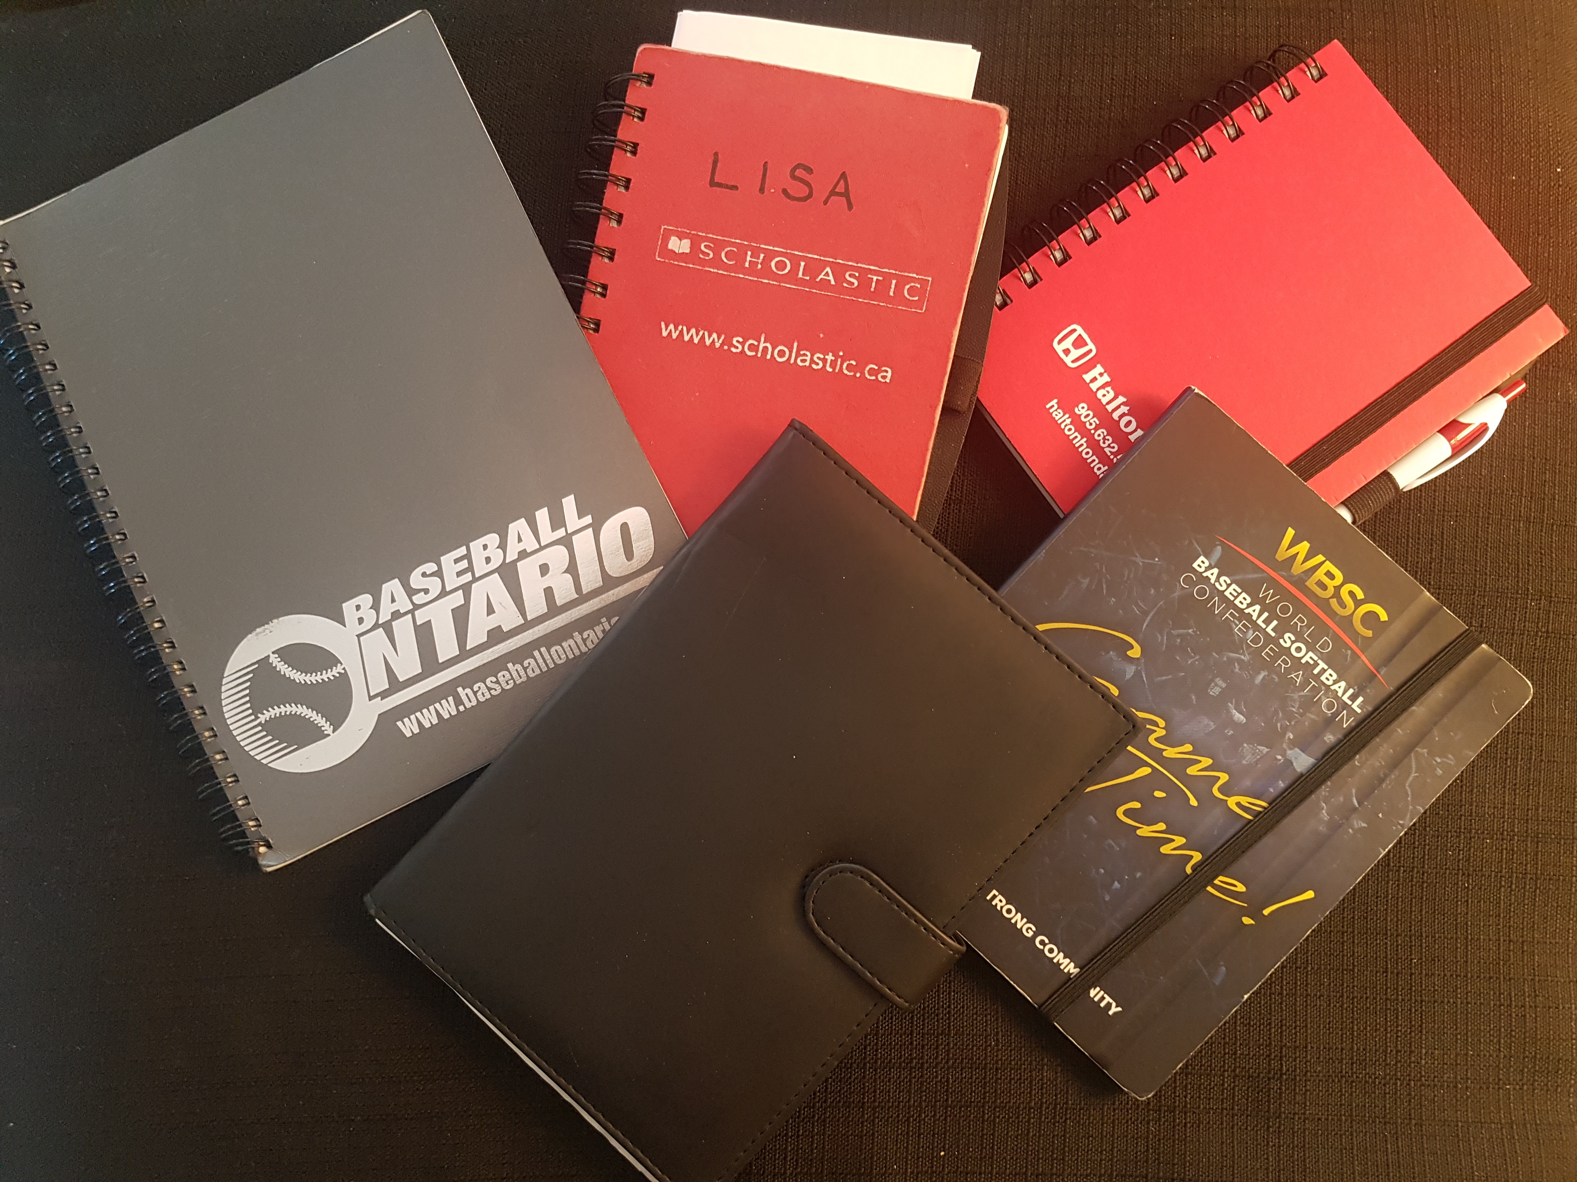
SELF – Keep a Journal or Log – Write it Down

Slide 9
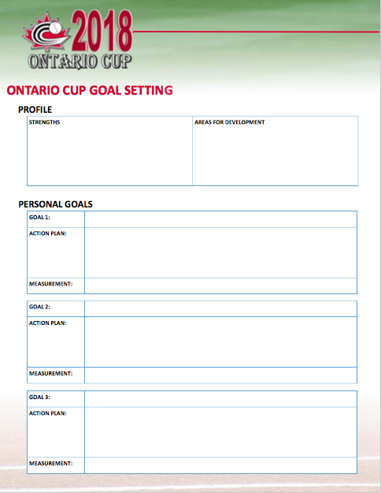
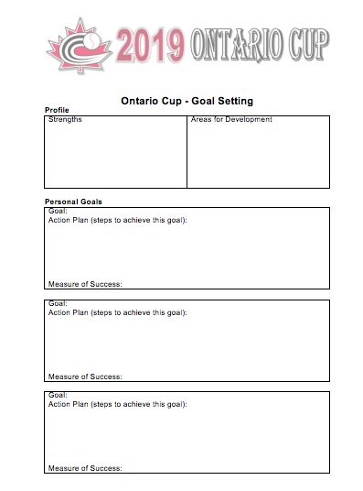
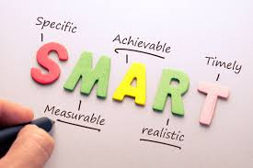
SELF – Set SMART Goals, Review, Revise

Slide 10
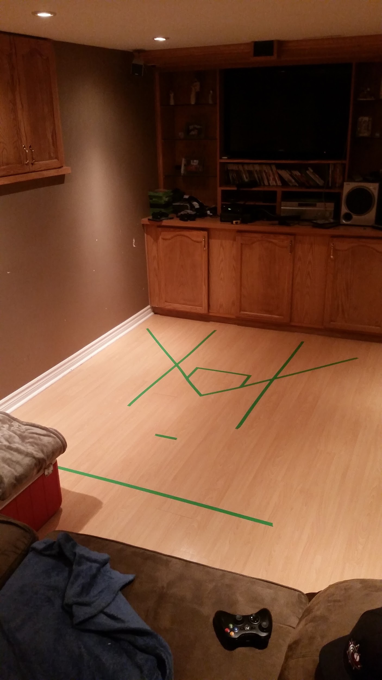
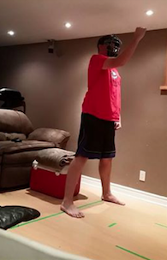
SELF – Working on Plate Stance, Footwork and Mechanics

Slide 11


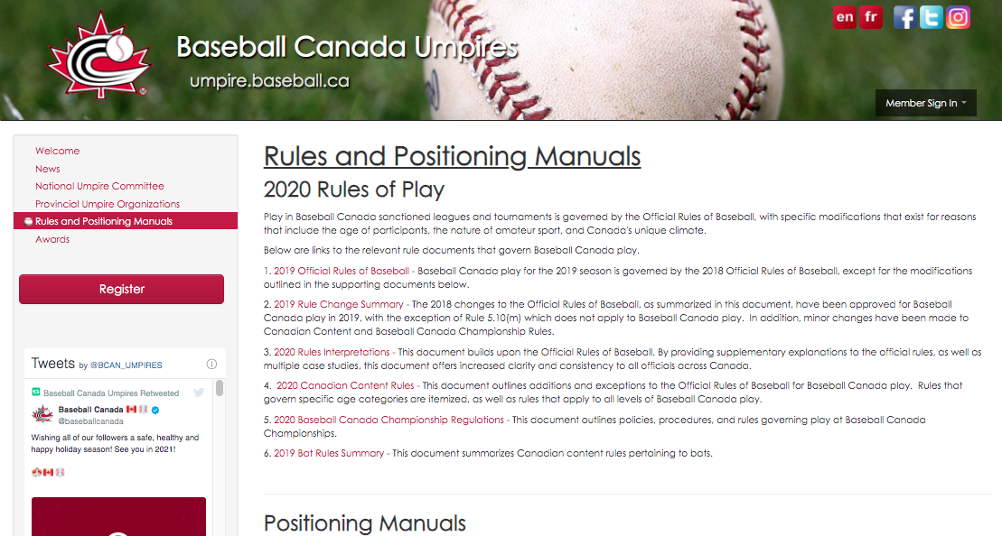

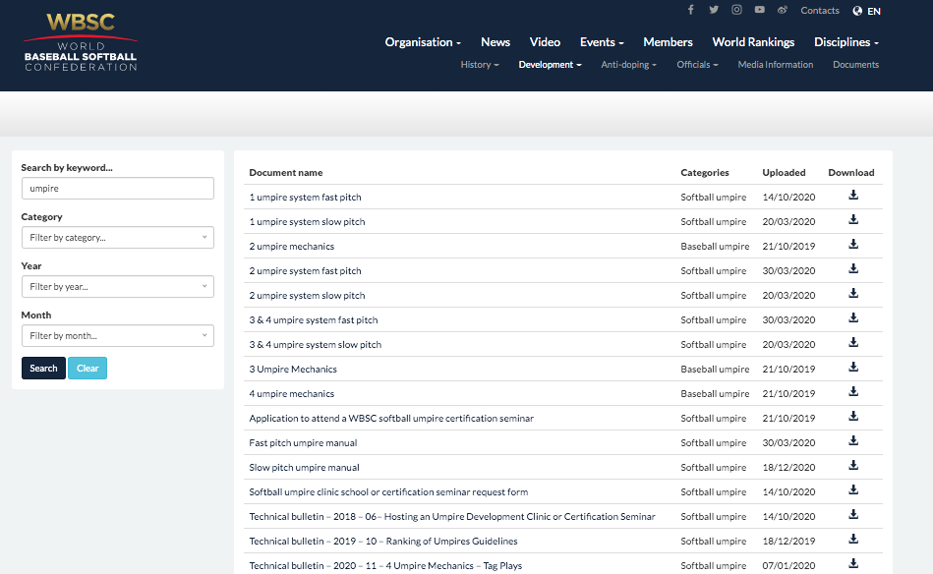


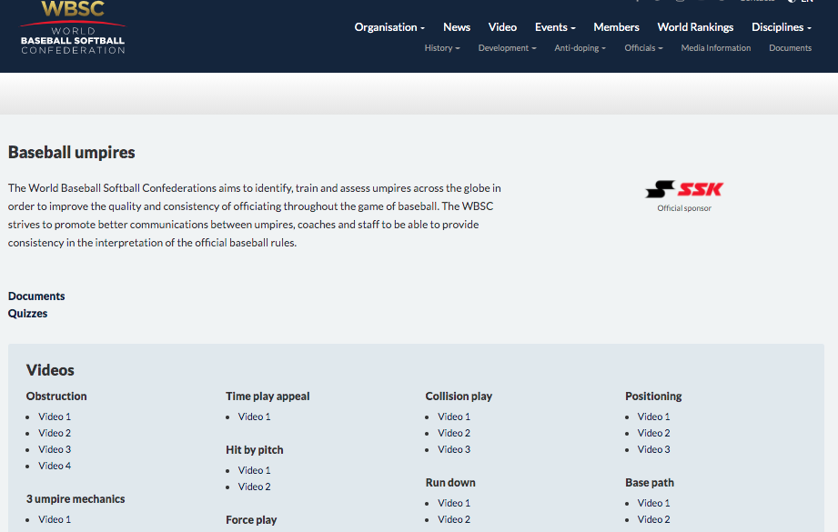
RESOURCES

Slide 12



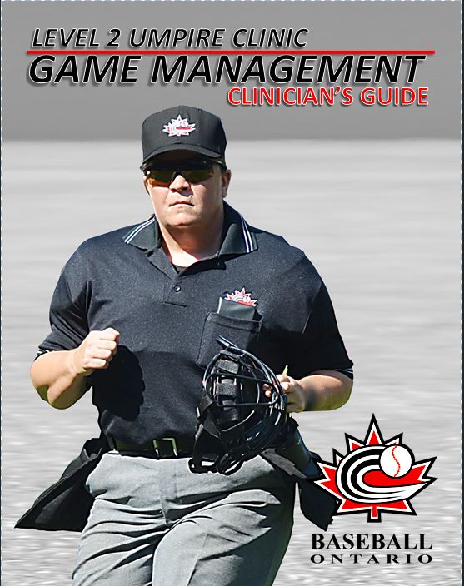



Slide 13
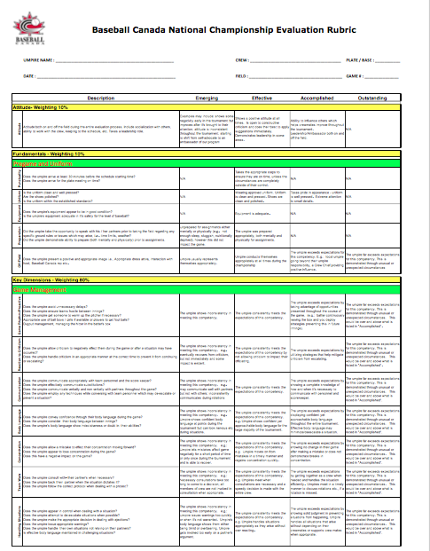
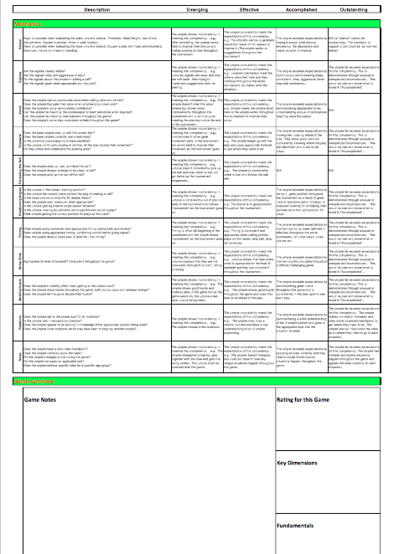
RESOURCES – National Umpire Evaluation Matrix

Slide 14
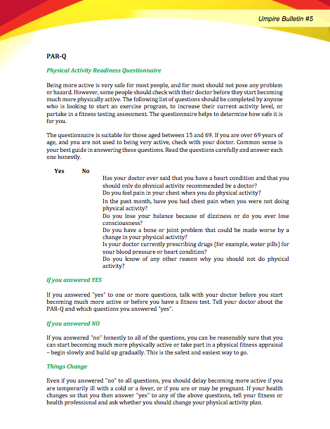

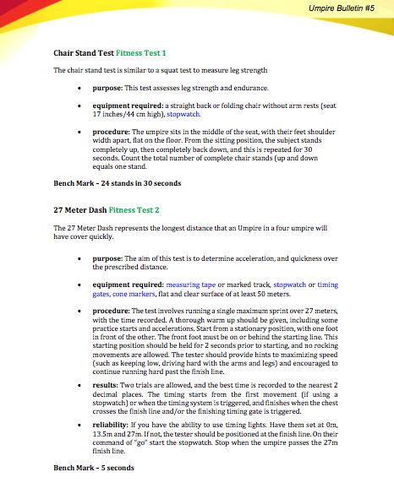
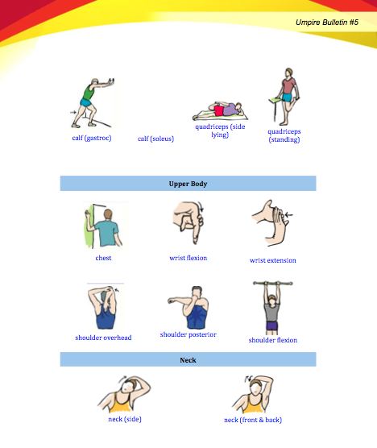
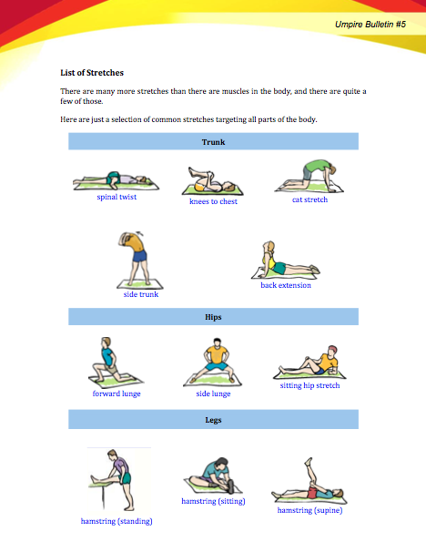
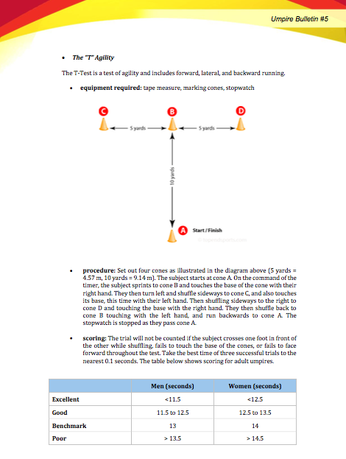
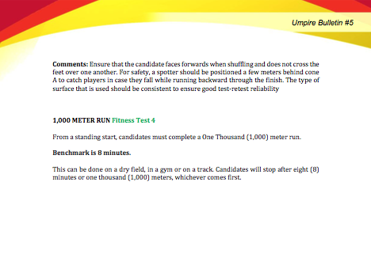
RESOURCES – WBSC Softball Umpire Fitness Testing

Slide 15
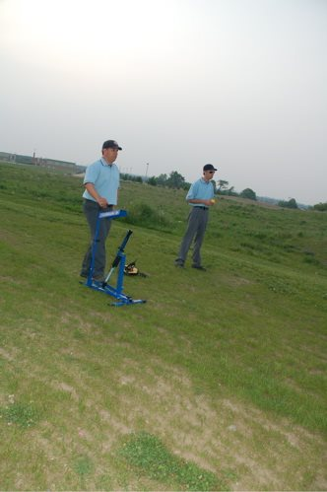
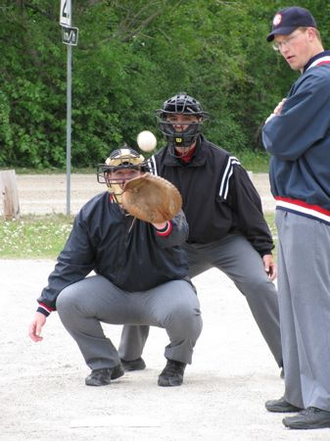
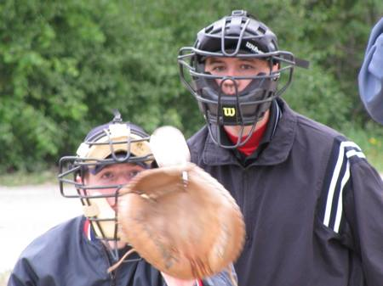
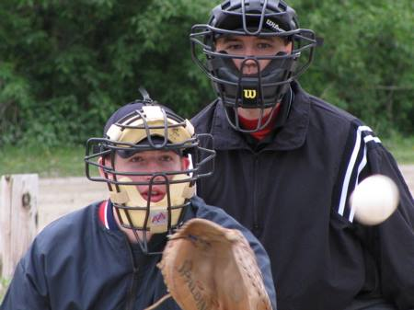
COLLEAGUES – Train together: eye tracking, plate stance, and mechanics

Slide 16
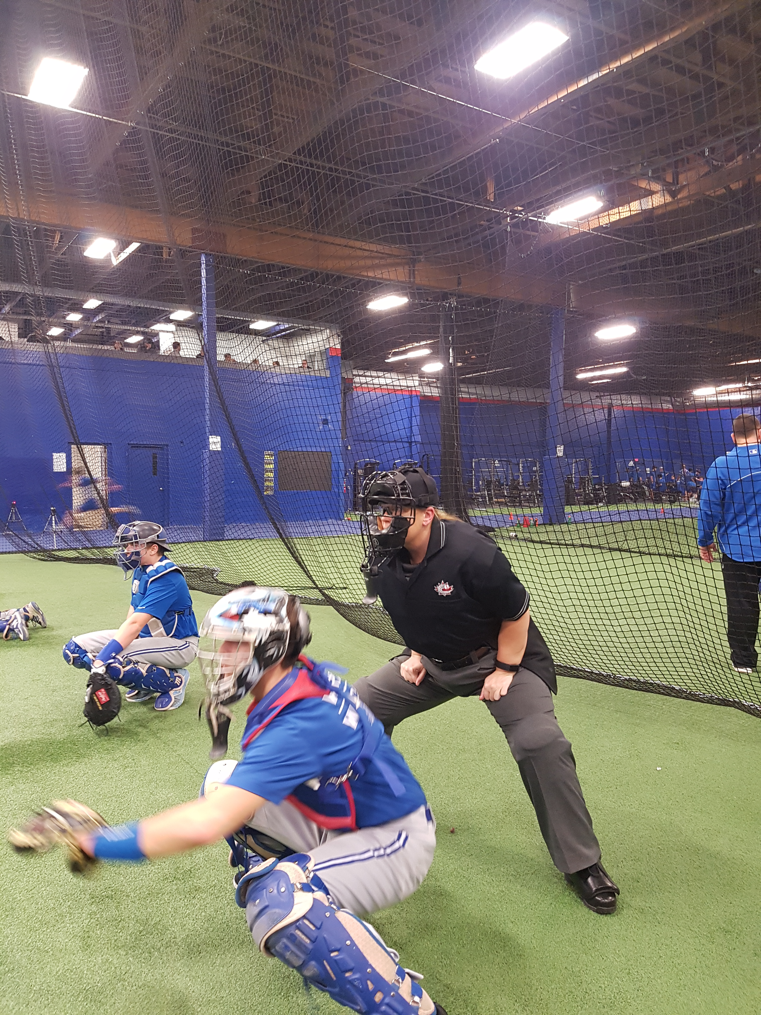
COLLEAGUES – Cage work, using technology to record and review

Slide 17
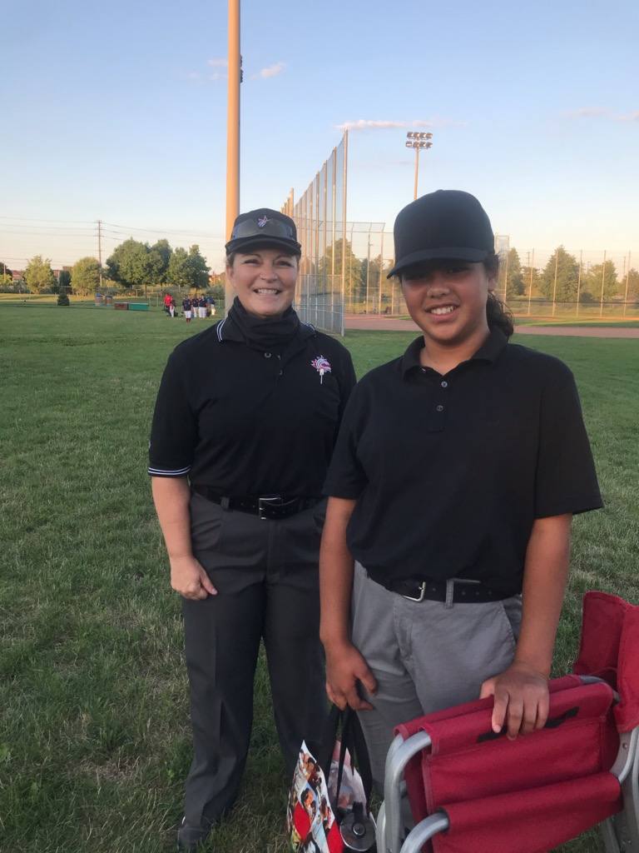
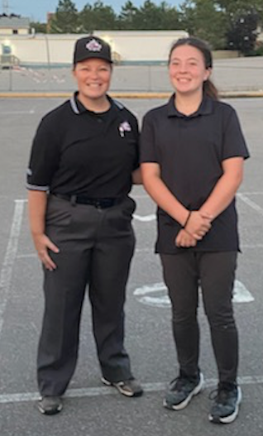
COLLEAGUES – Experienced Partners: New to Umpiring (Rookie Ball & 11U)

Slide 18
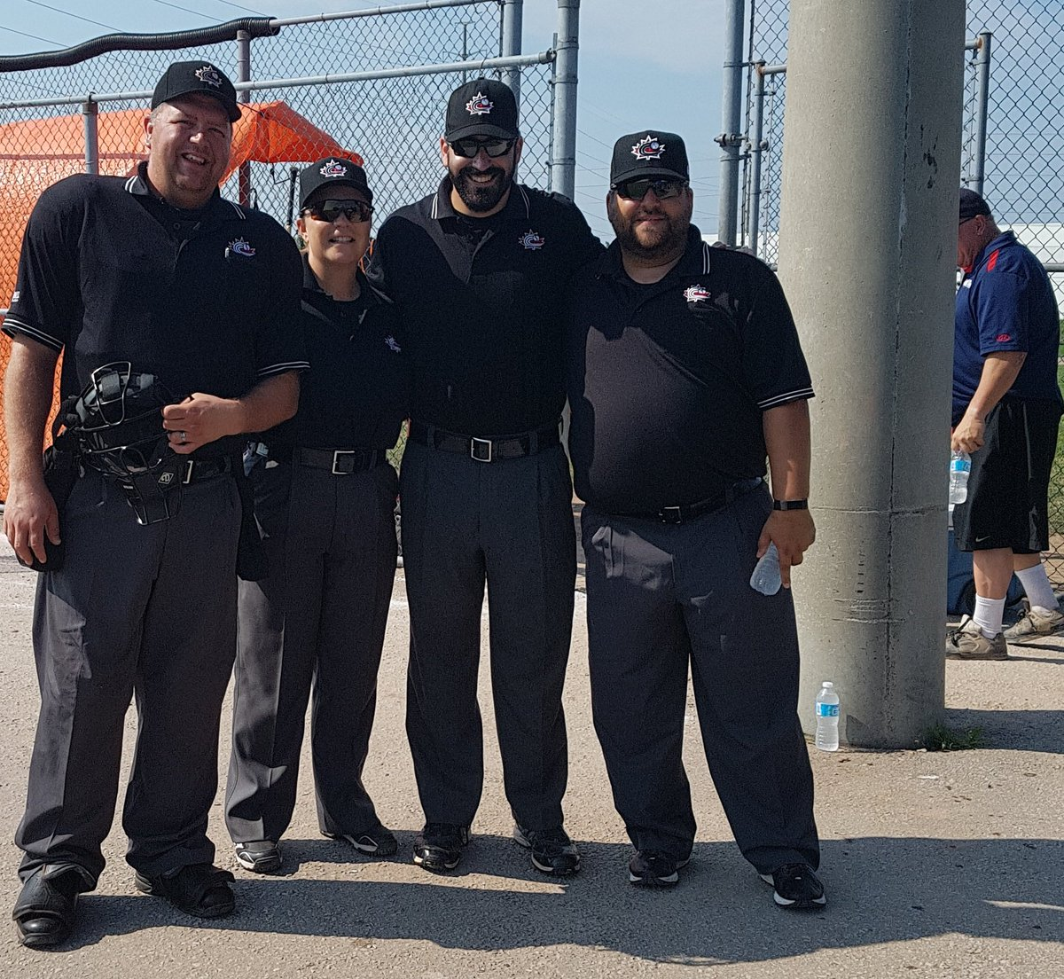
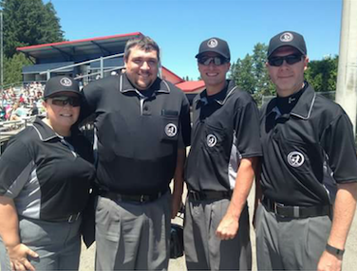
COLLEAGUES – Experienced Partners – 3 or 4 Umpire System

Slide 19
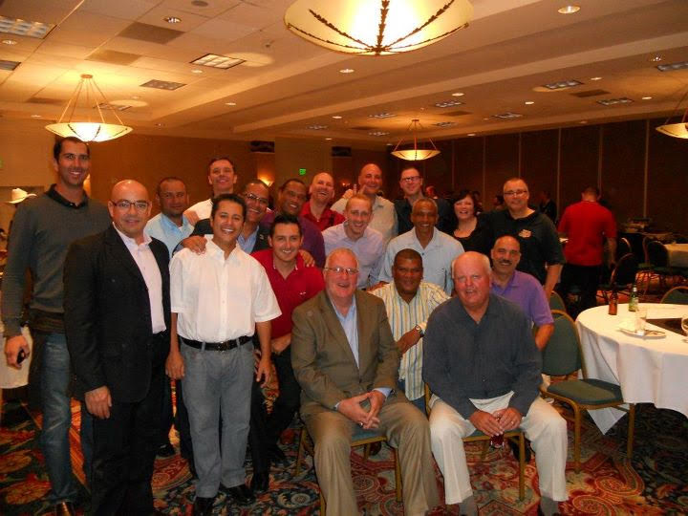
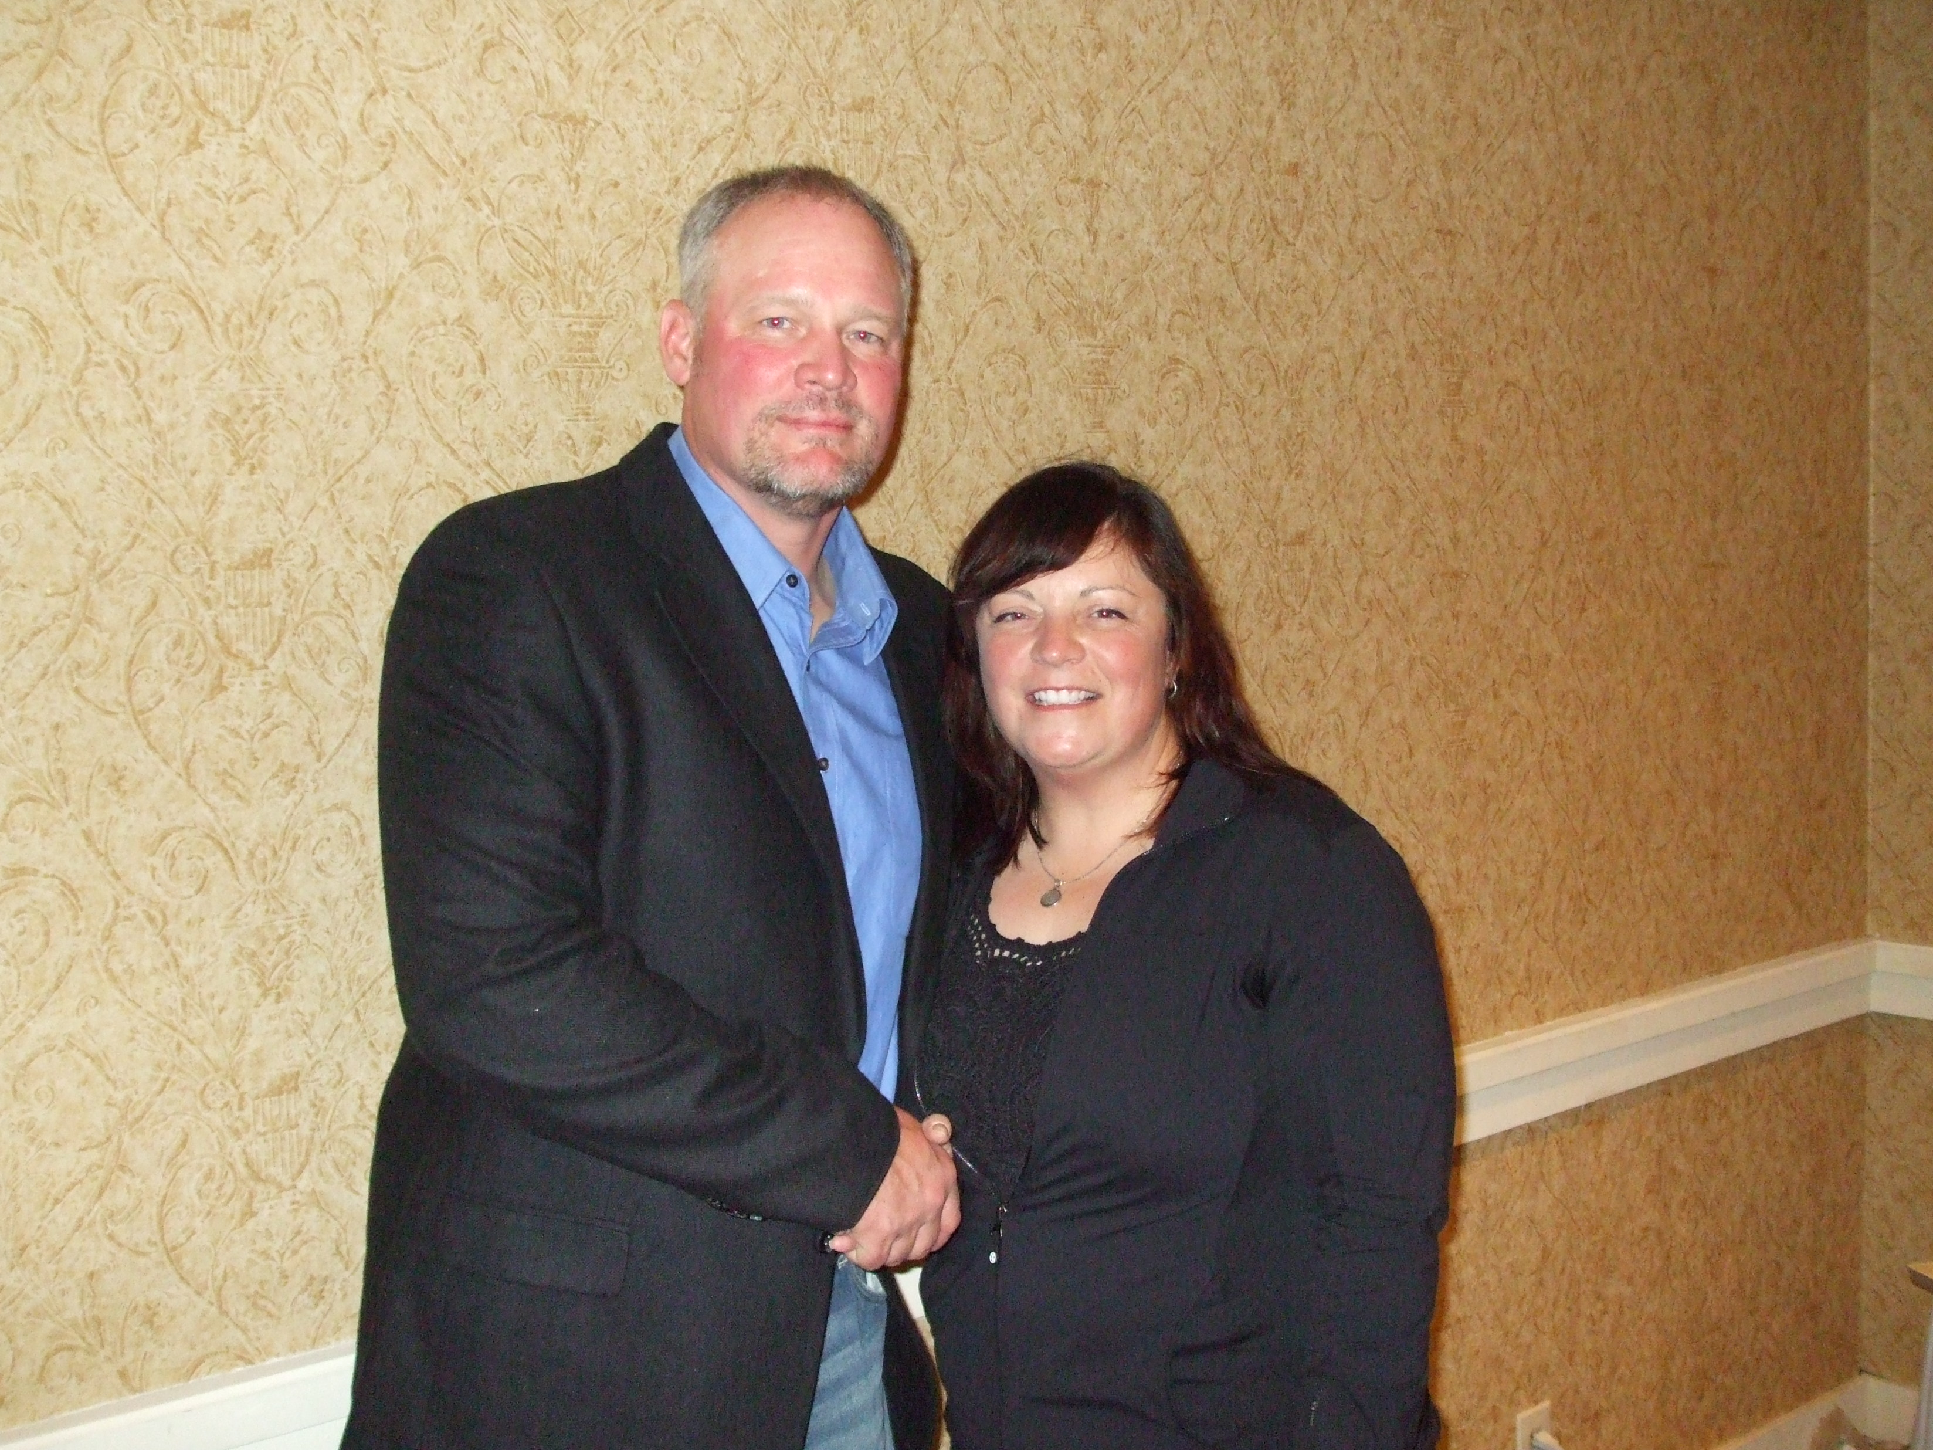
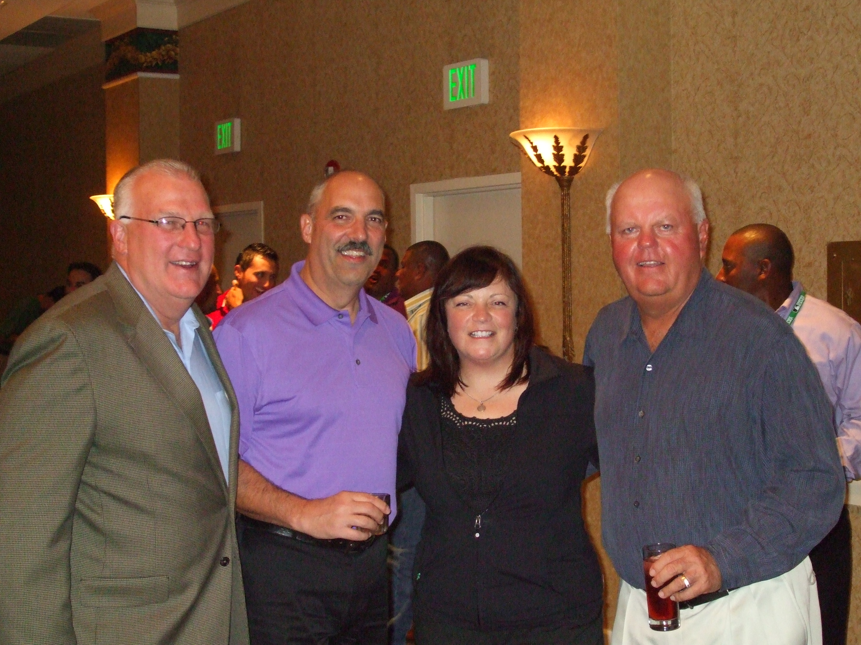
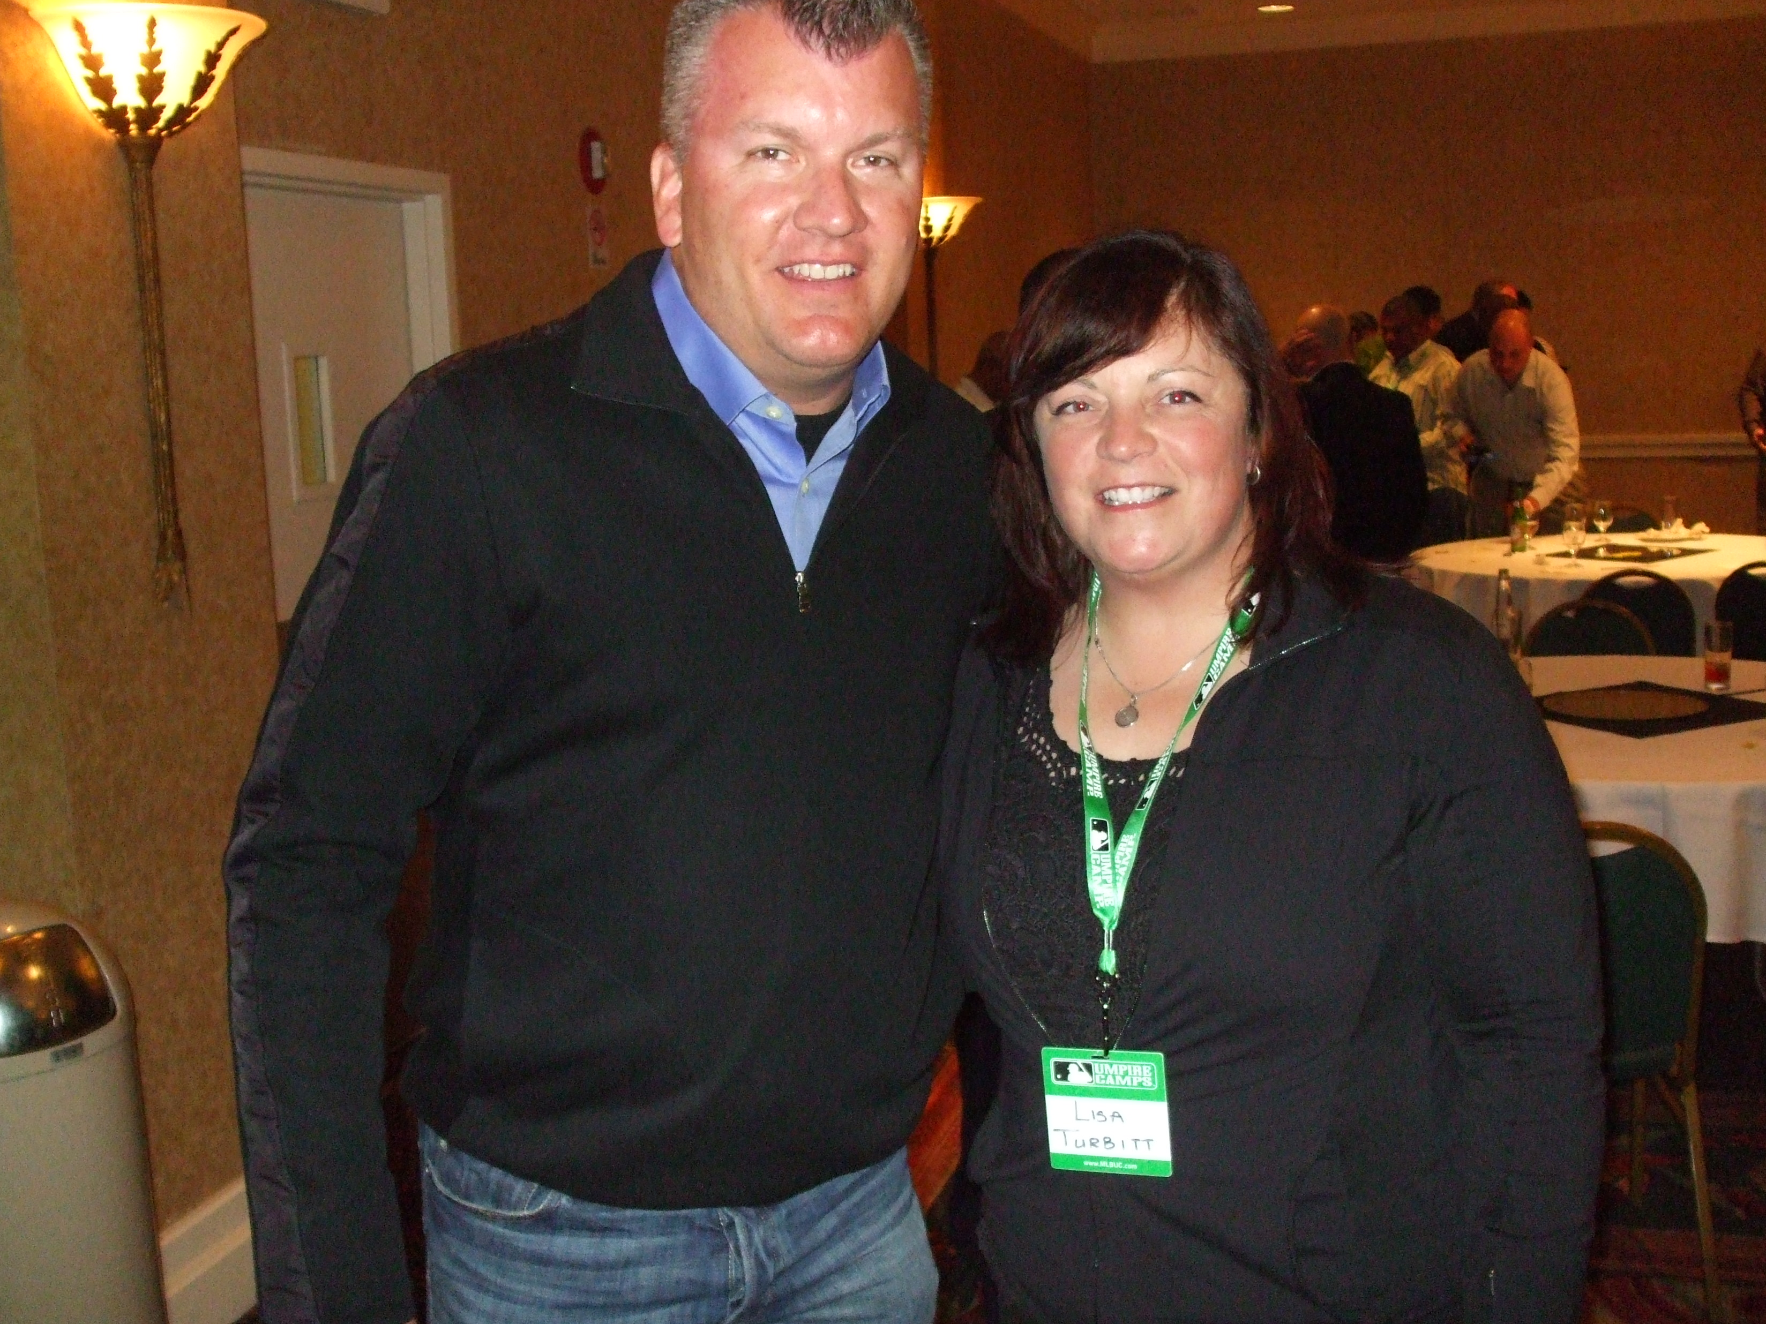
LEADERS – MLB/WBSC Umpire Camp

Slide 20
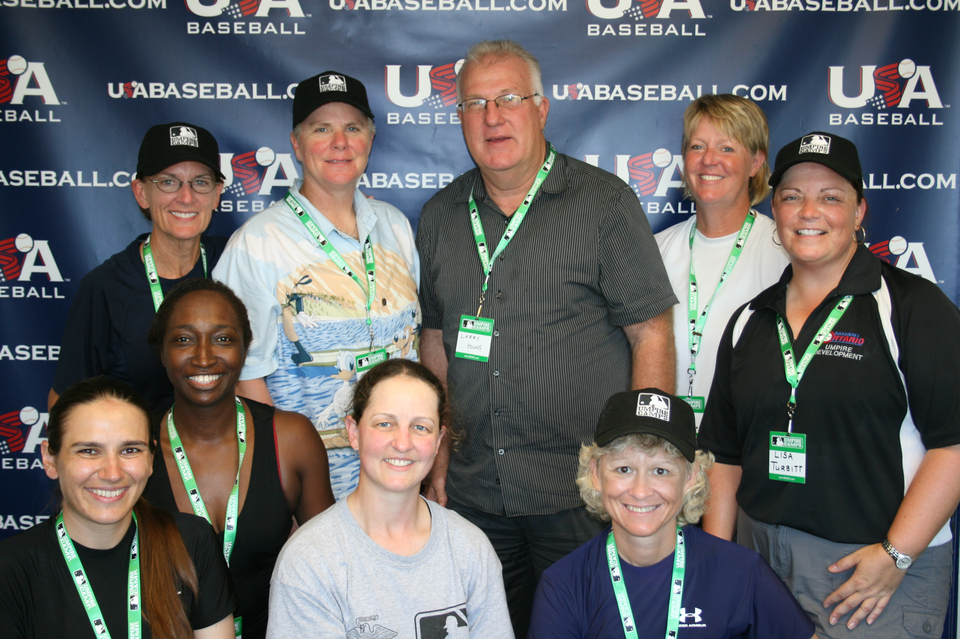
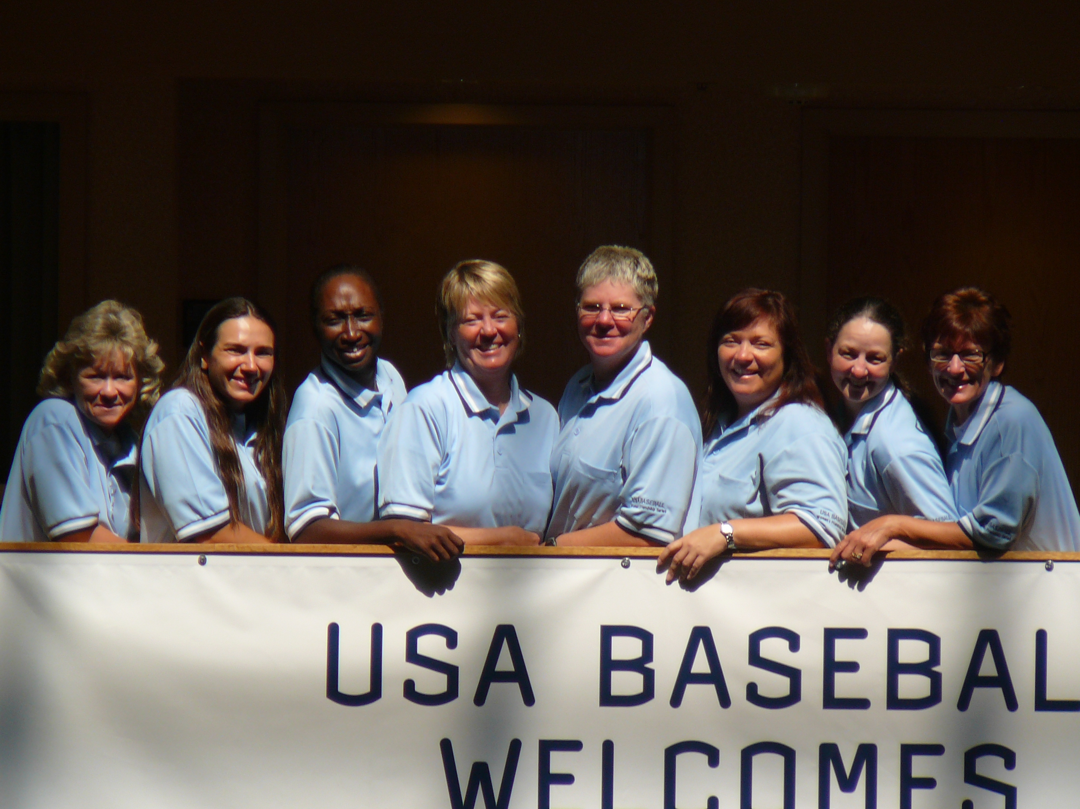
LEADERS – MLB Women’s Umpire Camp

Slide 21

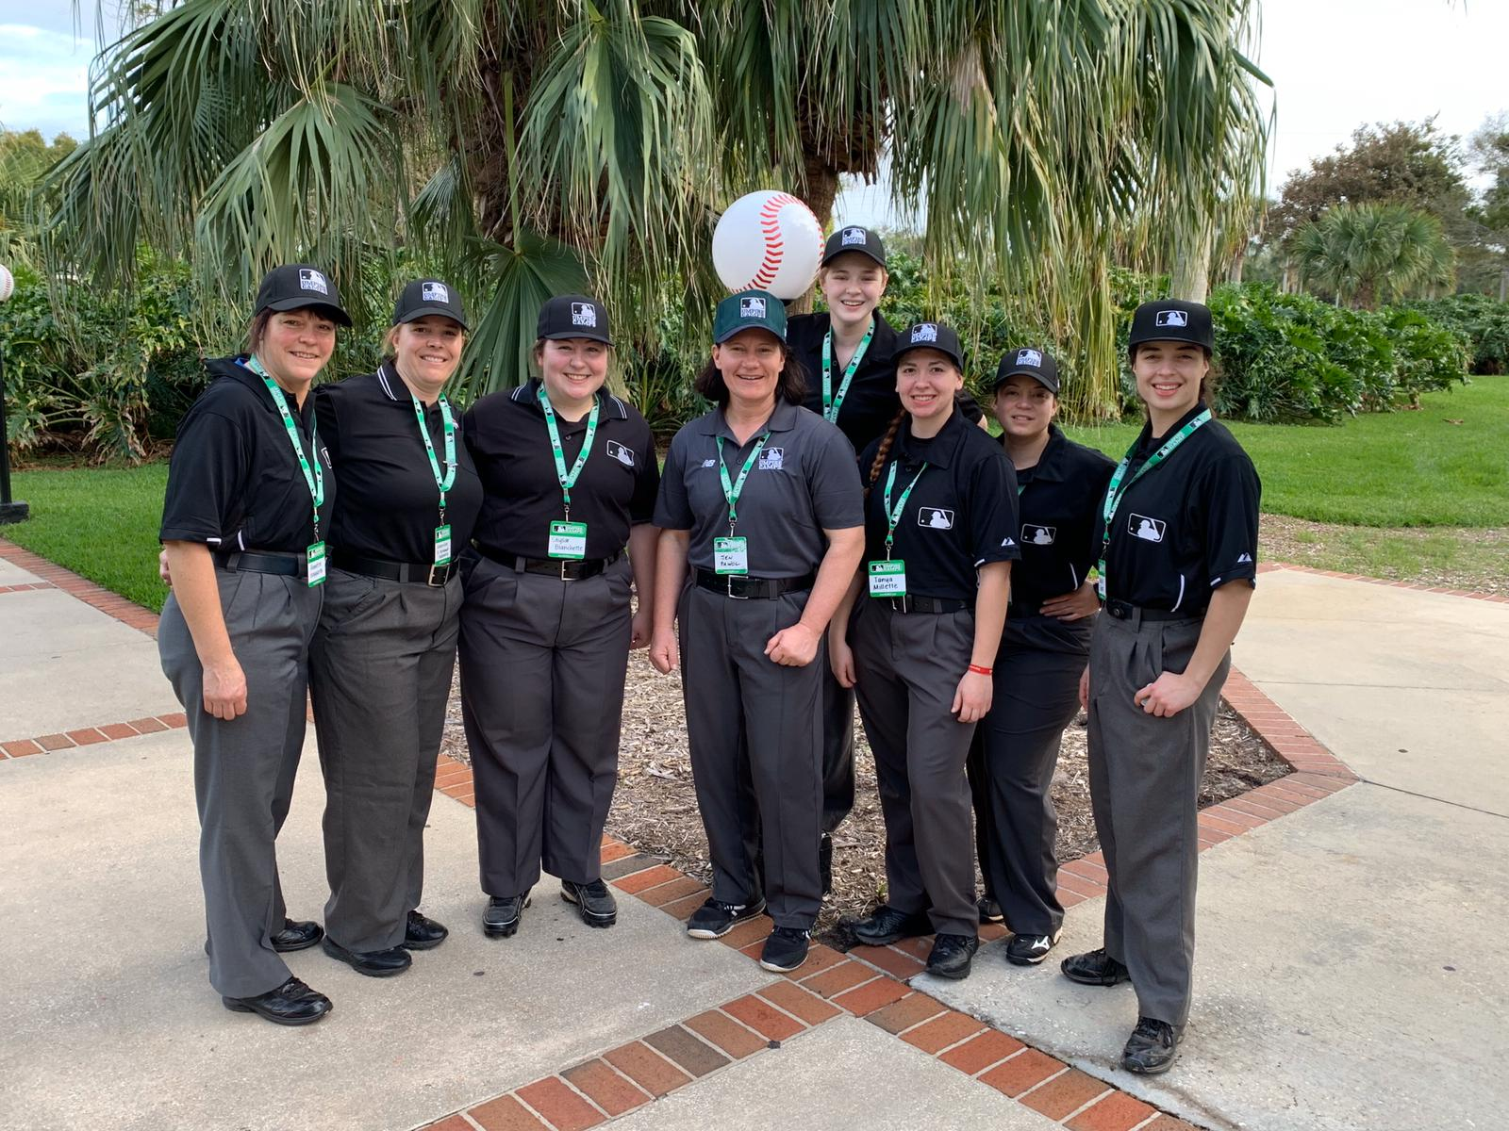
LEADERS – MLB Women’s Umpire Mini-Camp

Slide 22
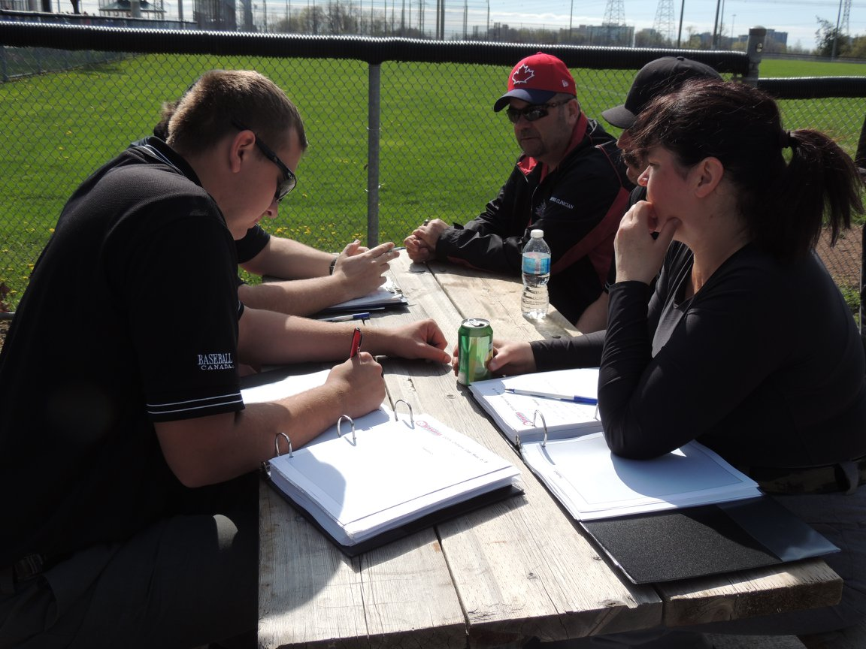
LEADERS – Formal Evaluation/Supervision/Feedback

Slide 23
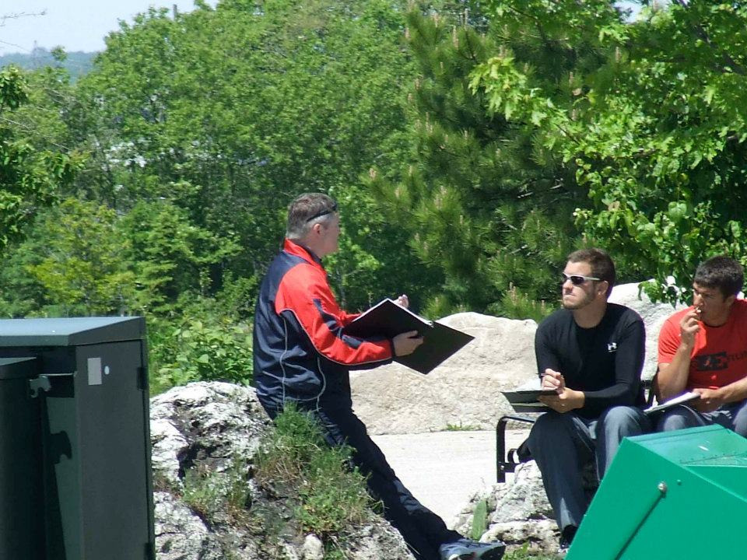
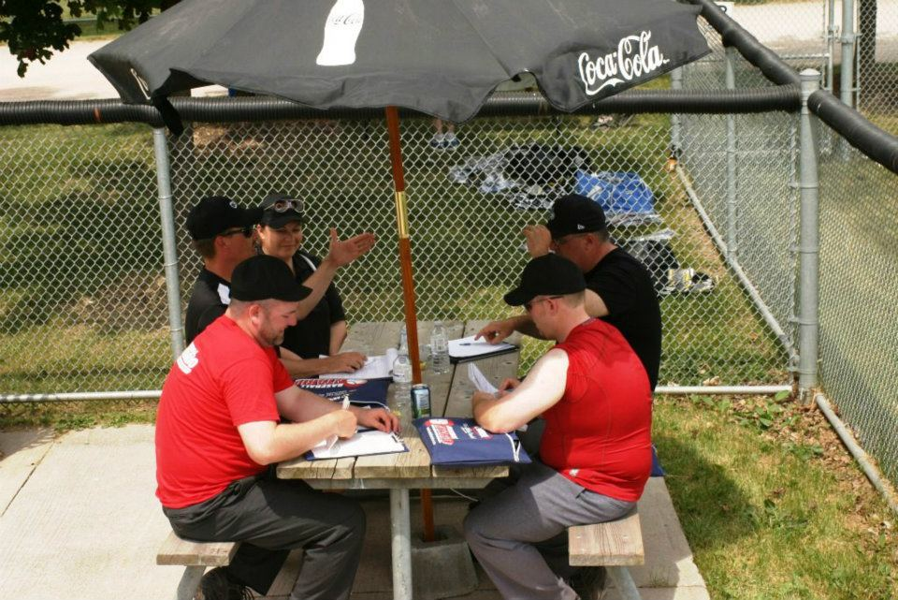
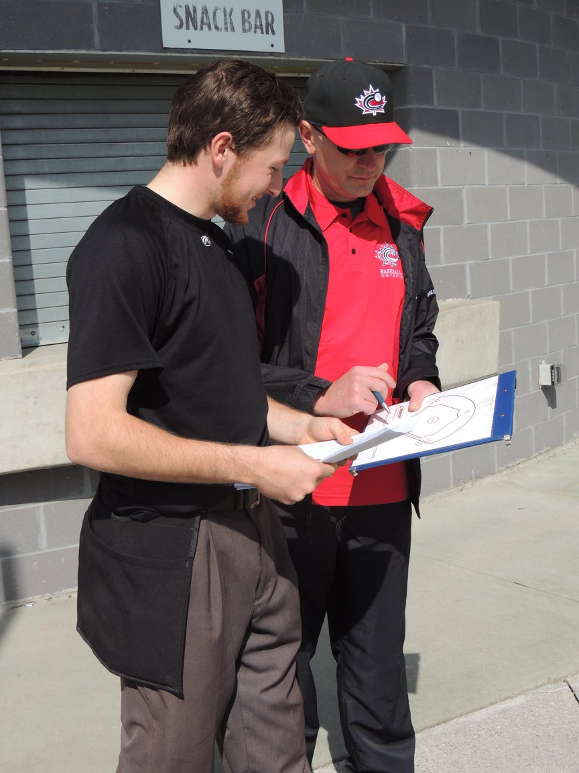
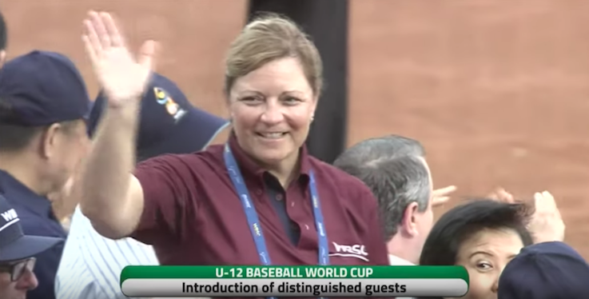
Feedback/Evaluations/Supervision/Director

Slide 24
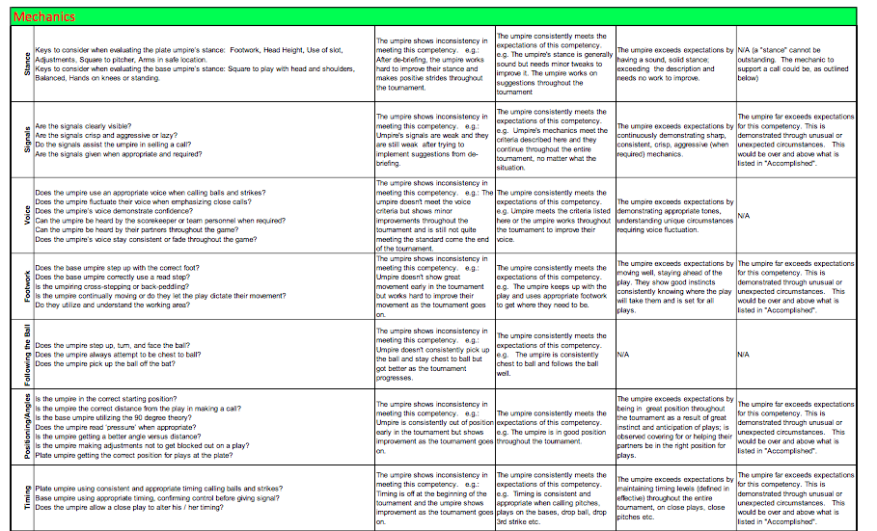

The Debrief - Expectations
Location – comfortable, private
Organization – prepare your feedback – structured flow
Visual Aids/Technology
2 Way Communication – allow/encourage note taking
Mitigate Possible Language Challenges
Indicate Rating (Matrix) - not personal beliefs/bias
Matrix expectations
Feedback based on performance (not supposition)
Strengths and Areas of Growth
Short Term/Long Term Goals and Strategies
Opportunity for Questions
Summarize

Slide 25
The Debrief - Communication
Approachability
Body Language
Clarity Of Feedback
Use of Time
Manner & Tone of Voice
Pedagogical Structure
Appropriate Feedback
Accurate Feedback

Slide 26


The Debrief - Technical
Preparation for Evaluations
Presence
Focus and Endurance
Mobility during Evaluation
Note Taking
Use of Technology
Pre Event Tasks
Paperwork
Post Event Tasks

Slide 27

The Debrief - Ambassadorship and Leadership
Ambassadorship
Leadership Skills
Handling Difficult Situations

Slide 28



Technology and Visuals
Picture is worth 1000 words
Communication (ESPECIALLY Language)
Role Playing
Comparison - start of game vs later
Goal setting
Progression towards goals.
Diagrams
Showing proper positioning/mechanics
Note taking - Sharing
Submitting & Sharing reports with others
Film with voice over

Slide 29

TECHNOLOGY - Capturing Game Situations.

Slide 30


TECHNOLOGY - Different Angles (Mobility of Supervisor)

Slide 31

TECHNOLOGY: Starting position & Distance for Plays

Slide 32


TECHNOLOGY - Plate Stance and Mechanics

Slide 33


TECHNOLOGY – Plate Stance and Mechanics

Slide 34

TECHNOLOGY - Video, Reply, Pictures

Slide 35

TECHNOLOGY – Piloting Hawk-Eye

Slide 36
“Receiving” Evaluation/Supervision
Guide you…NOT define you

Slide 37





ATTIUDE
OFF-FIELD
TEAM WORK
COACHABILITY
DESIRE to LEARN
SELF-IMPROVEMENT

Slide 38

Social Media
Be cautious of using social media.
Guidelines around using/posting on social media for umpires and/or supervisors
May choose to avoid social media altogether during events.
Posts on social media you can’t be taken back.
The worst choice you can make is to post something negative on social media.
May result in additional consequences.

Slide 39
S – C – L
          SELF
          Self Reflection/Analysis
          Goal Setting
          Accessing Resources
COLLEAGUES
Work with a Mentors/Colleagues
Watch/Observe others
Ask questions, learn from their experience
LEADERS
Supervisors
Evaluators
Umpire Directors

Slide 40



Supervisor/Evaluator/Director

Slide 41


SELF – Accessing Resources, Goal Setting

Slide 42


COLLEAGUES – Learning from Others, Feedback
Notes:
I

Slide 43

COLLEAGUES – Feedback

Slide 44

LEADERS – Supervisor Evaluation

Slide 45
S – C – L
          SELF
          Self Reflection/Analysis
          Goal Setting
          Accessing Resources
COLLEAGUES
Work with a Mentors/Colleagues
Watch/Observe others
Ask questions, learn from their experience
LEADERS
Supervisors
Evaluators
Directors

Slide 46


Slide 47
Additional Resources

Slide 48

Baseball Canada – Supervisor Evaluation Matrix

Slide 49

Baseball Canada – Supervisor Evaluation Matrix

Slide 50

Baseball Canada – Supervisor Evaluation Matrix

Slide 51


Game Supervision Tracking – Summary Forms

Slide 52


Baseball Canada Supervisor Meeting Agenda

Slide 53

RESOURCES – Manuals with Matrix and Evaluation Standards

Slide 54

MiLB – Evaluation Criteria

Slide 55


MiLB – Evaluation Criteria

Slide 56


MiLB – Evaluation Criteria

Slide 57
Baseball Canada Umpire Supervisor Evaluation

Slide 58

Softball Canada – Evaluation Matrix

Slide 59



WBSC Baseball – Evaluation Criteria

Slide 60


WBSC Softball – Evaluation Criteria

Slide 61



WBSC - Umpire Evaluation Procedures

Slide 62

RESOURCES – Baseball Ontario Umpire Levels Progression

Slide 63
Softball Alberta
https://www.softballalberta.ca/#
Softball Canada
https://softball.ca/programs/umpires
Baseball Ontario
https://www.baseballontario.com/Umpires/program/Special.aspx?TopMenuID=10006
Baseball Alberta
http://www.baseballalberta.com/content/around-the-horn-zoom-sessions
Baseball Canada
http://umpire.baseball.ca/index.php?page=213
WBSC - Softball Umpires
https://www.wbsc.org/officials/softball-umpires
WBSC - Baseball Umpires
https://www.wbsc.org/officials/baseball-umpires
WBSC - Documents (Fitness Test, Rules, Umpire Manuals, etc.)
https://www.wbsc.org/documents/search?search=

Slide 64
Self-Reflection - Self-Analysis
Getting feedback is important and vital to develop
Colleagues or Leaders are not always available
Analyze your own performance and reflect how you did. Use this information to set your goals.

Slide 65
Self-Reflection - Self-Analysis
PRACTICE - PRACTICE – PRACTICE
Mechanically sound plate stance - Video is a great tool
Maintaining plate stance - Fatigue or lack of leg strength?
Head height too high or low or in a different spot every pitch?
Often an inconsistent strike zone is a result of mechanical issues with the umpire’s plate stance.

Slide 66
Self-Reflection - Self-Analysis
Consistent plate stance - more consistent strike zone
Practice seeing pitches - different speeds, movement
Work with different catchers - different styles, size
Learn to work and adapt to changed
Many umpires initially struggle when they move to a higher level of baseball - speed and movement of pitches.

Slide 67
Self-Reflection - Self-Analysis
Cage work (machine or pitchers working out pre-season)
Inter-squad games or exhibition
Track in your umpire’s journal
Record your performance
If your goal is to improve an aspect of your officiating - write down these goals and track your progress.

