Slide 1
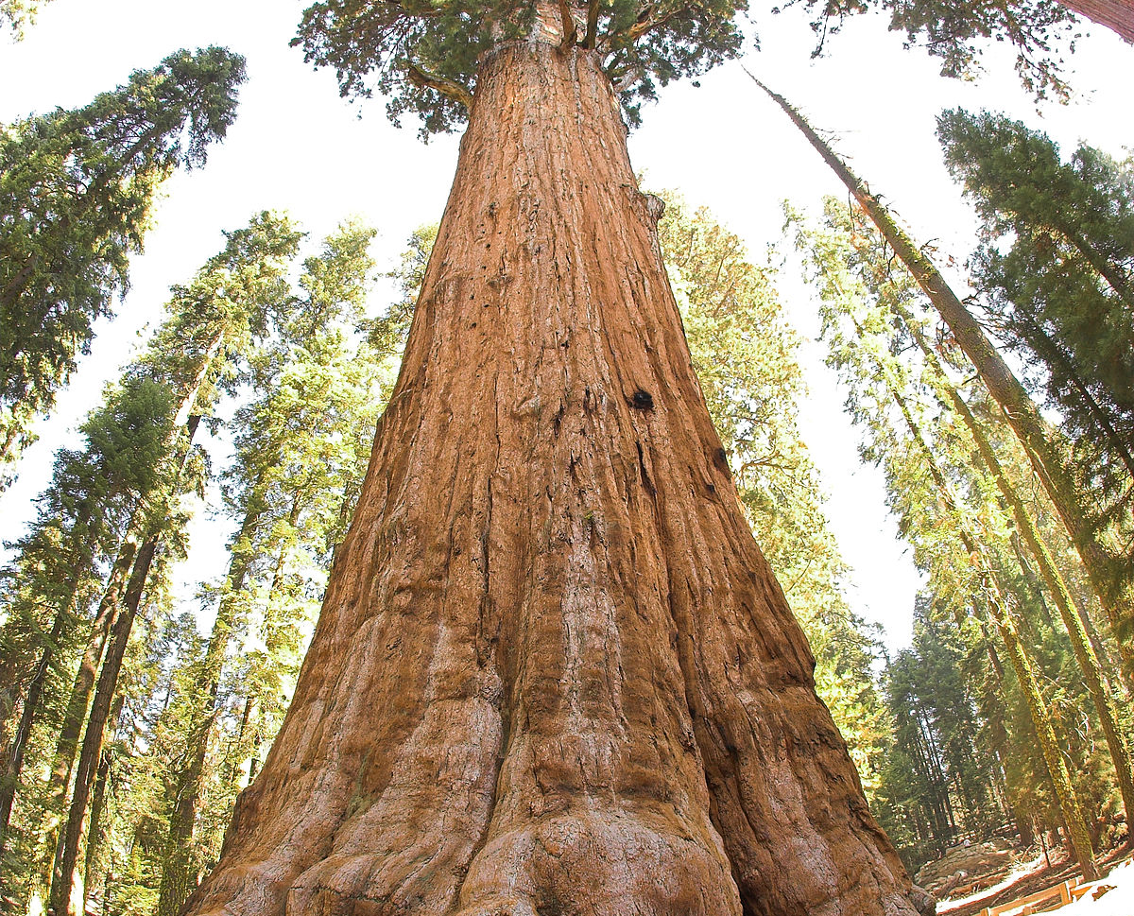
Deeply Rooted in confidence
with Jen Pawol
evolve2excellence@gmail.com
Notes:
Out of season, enjoy backpacking ang hiking in the NPs with family and friends
Disconnect from devices, wilderness, deep reflection, new perspectives for the next season
Sequoia National Park, California

Slide 2
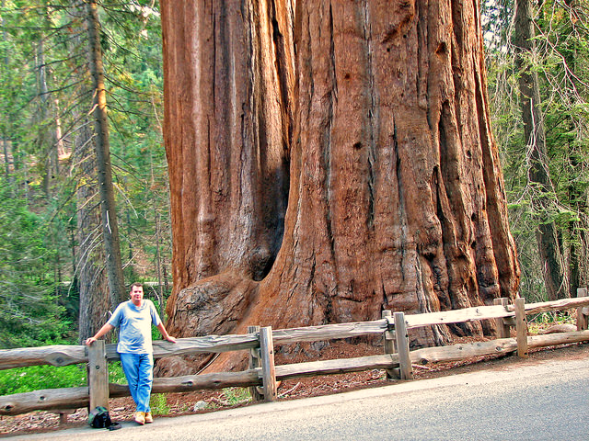

What size is your confidence level?

Slide 3

Introduction
  Do you feel like your confidence is the size of a house plant? Or a Sequoia?
    How deep does your confidence go?
    What happens to your game management when the wind blows?
    Their enormous root systems go deep down and wide
    Trunk growth: It’s all about the base!
Notes:
The General Sherman Tree, largest single stem tree in the world, 2300-2700 years old, height of 87 meters (286ft), circumference of 34 meters (113ft)

Slide 4
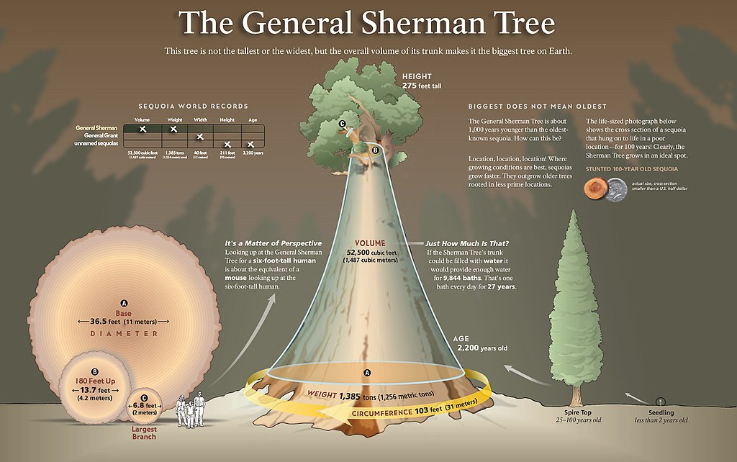

Slide 5
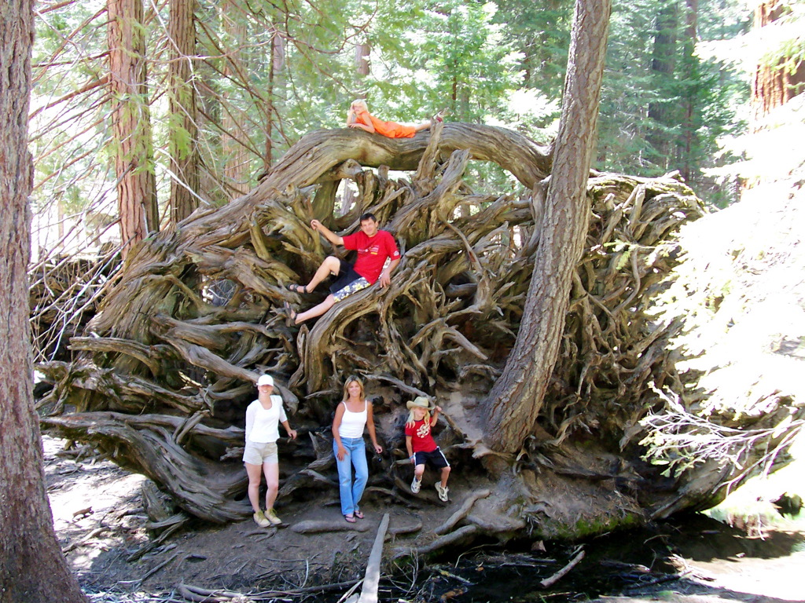

Slide 6

BIG dreams & BIG goals mean BIG changes to your game to get where you want to go = post season, moving up levels, crew chief, UIC, Olympics

Slide 7
Jen’s Background
Transitioned from catcher to umpire
Opportunity to get paid in the sport I love
Unique career path for a woman
Go for It attitude!
Horizon
Calls BFA, MFA, K-12 Art Educator, Evolve 2 Excellence LLC Business Owner

Slide 8
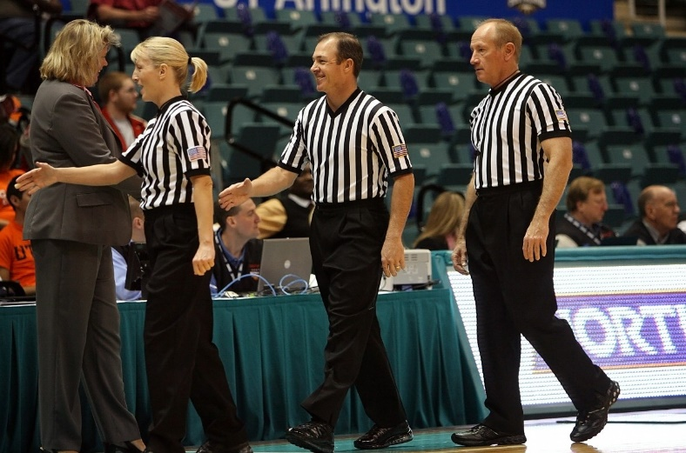
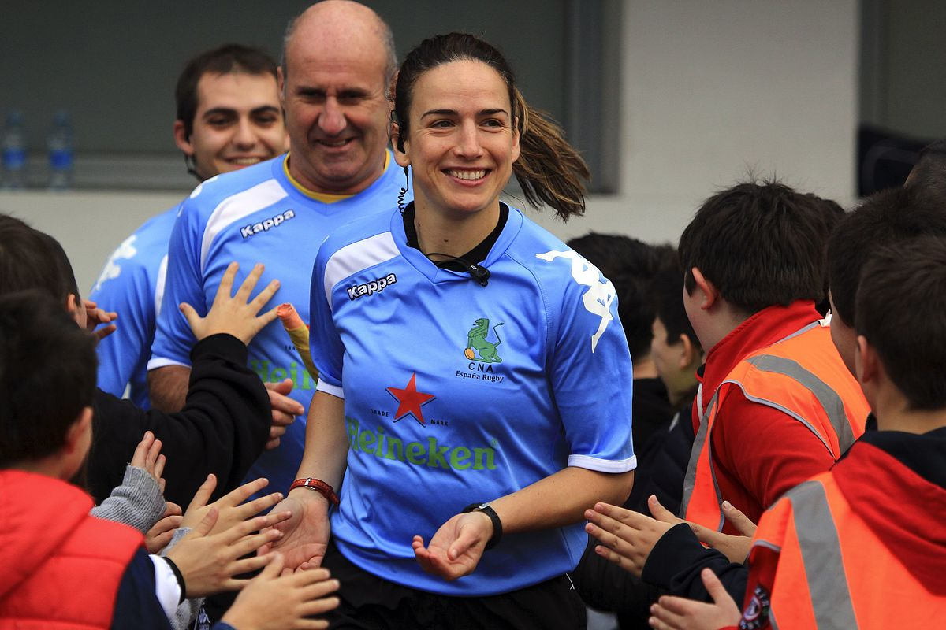
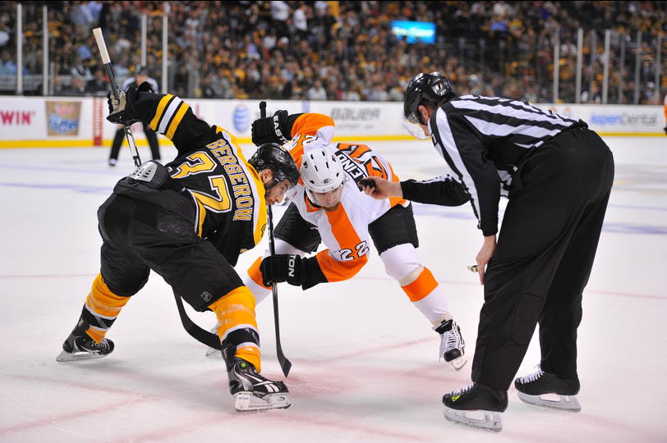
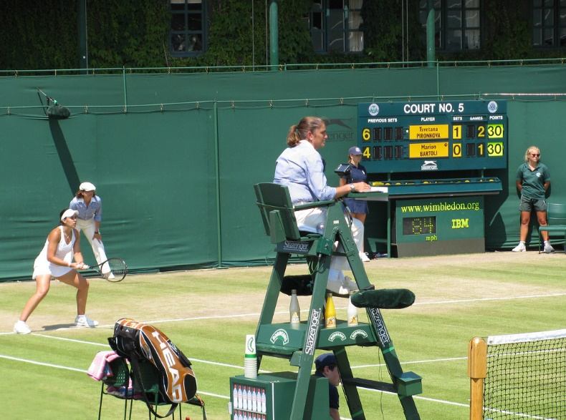
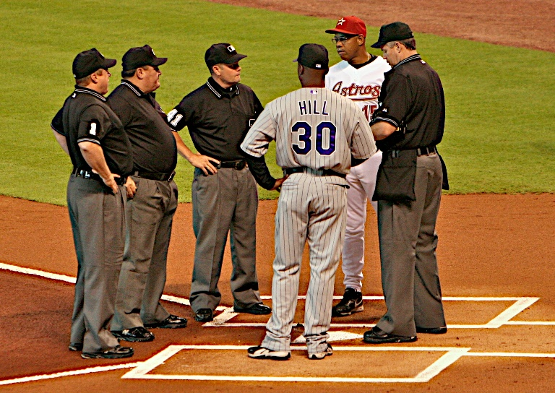
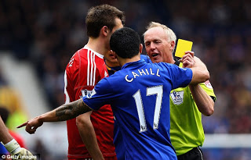
Let’s Define Confidence
Notes:
Mary Jackson NASA Headquarters renames, Hidden Figures movie, recent MARS landing explorations
More likely to become an astronaut than an MLB umpire

Slide 9
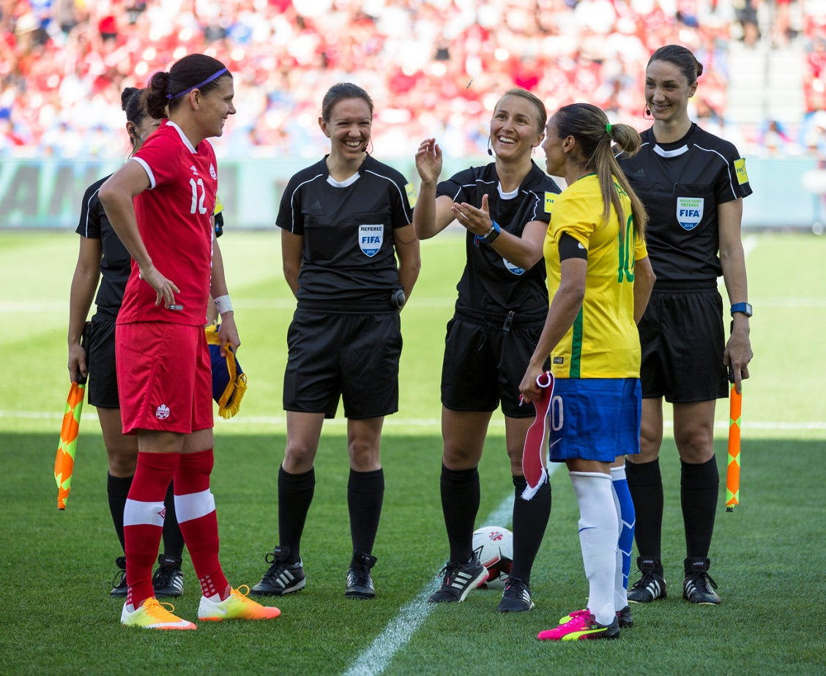
Definitions of Confidence
noun: person, place, or thing
The feeling or belief that one can rely on someone; firm trust
“we had every confidence in the staff”
- Oxford Languages

Slide 10

Definitions of Confidence
The state of feeling certain about the truth of something
“it is possible to say with confidence that he applied the rule correctly based on how certain the official was while explaining the call to the coach”
- Oxford Languages
This Photo by Unknown Author is licensed under CC BY-SA

Slide 11
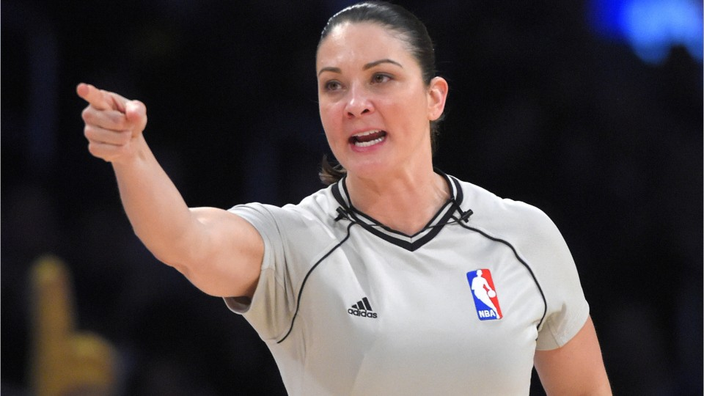
Definitions of Confidence
A feeling of self-assurance arising from one’s appreciation of one’s own abilities or qualities.
“she’s brimming with confidence”
- Oxford Languages

Slide 12
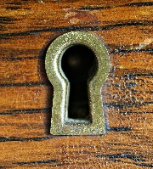
Confidence is strengthened through trust in…
An Official’s Confidence
Rules Knowledge
Crew & Staff
Your Ability

Slide 13
Game Journal in Excel
Date | Location | Time | Extras | Position | Guests | Workouts | Feels Like Temp | Humidity | Notes
4/4 | GREENVILLE | 7:05pm | 10 | Base |  | Yoga | 91* | 70% | Balk - no stop #34
4/8 | KANNAPOLIS | 7:00pm | Rain out | Base |  | Swim | 92* | 95% | Did not start, postponed to May 18 @ 5:30pm
5/17 | CHARLSTN | 7:05pm | 9 | Plate | Eval | Body Pump | 90* | 80% | Catcher Interference, Charleston #51 42:33:02 – 43:00:00
5/23 | HAGRSTN | 7:05pm | 9 | Plate | Dad | Golf 9:32am | 88* | 73% | Double run down between 3+2, 2+1

Slide 14
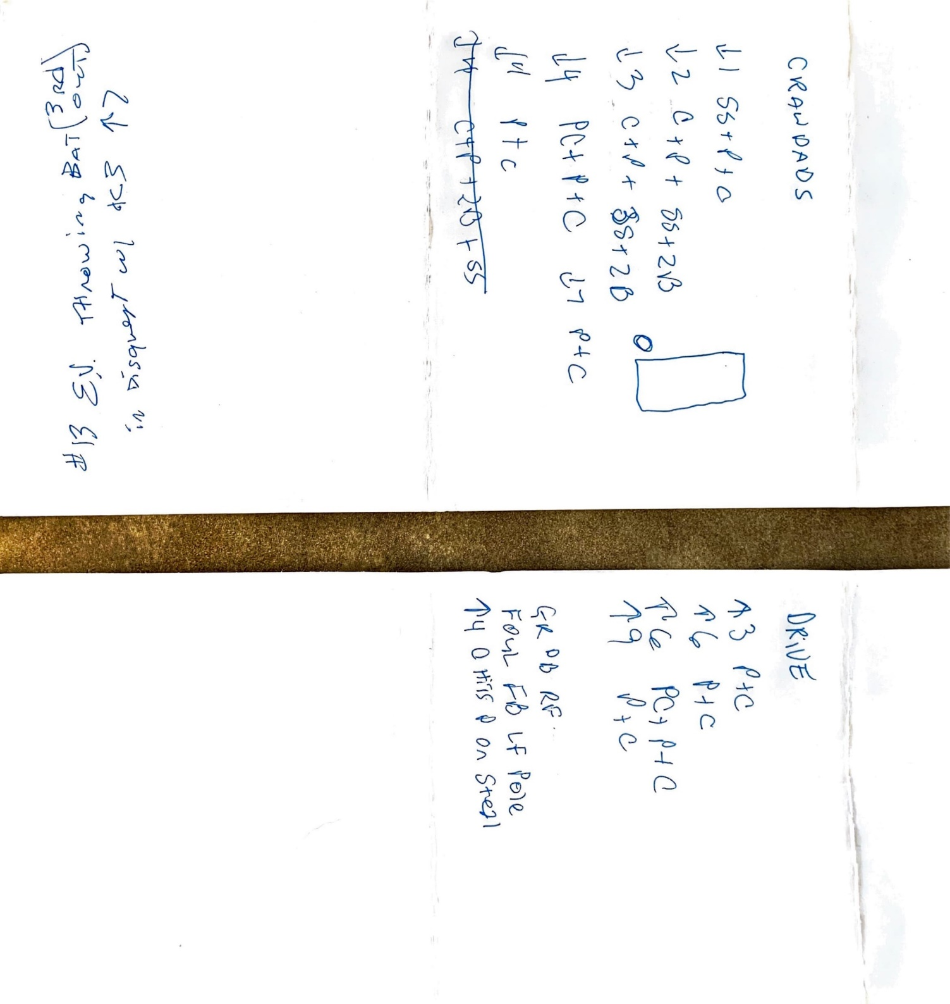
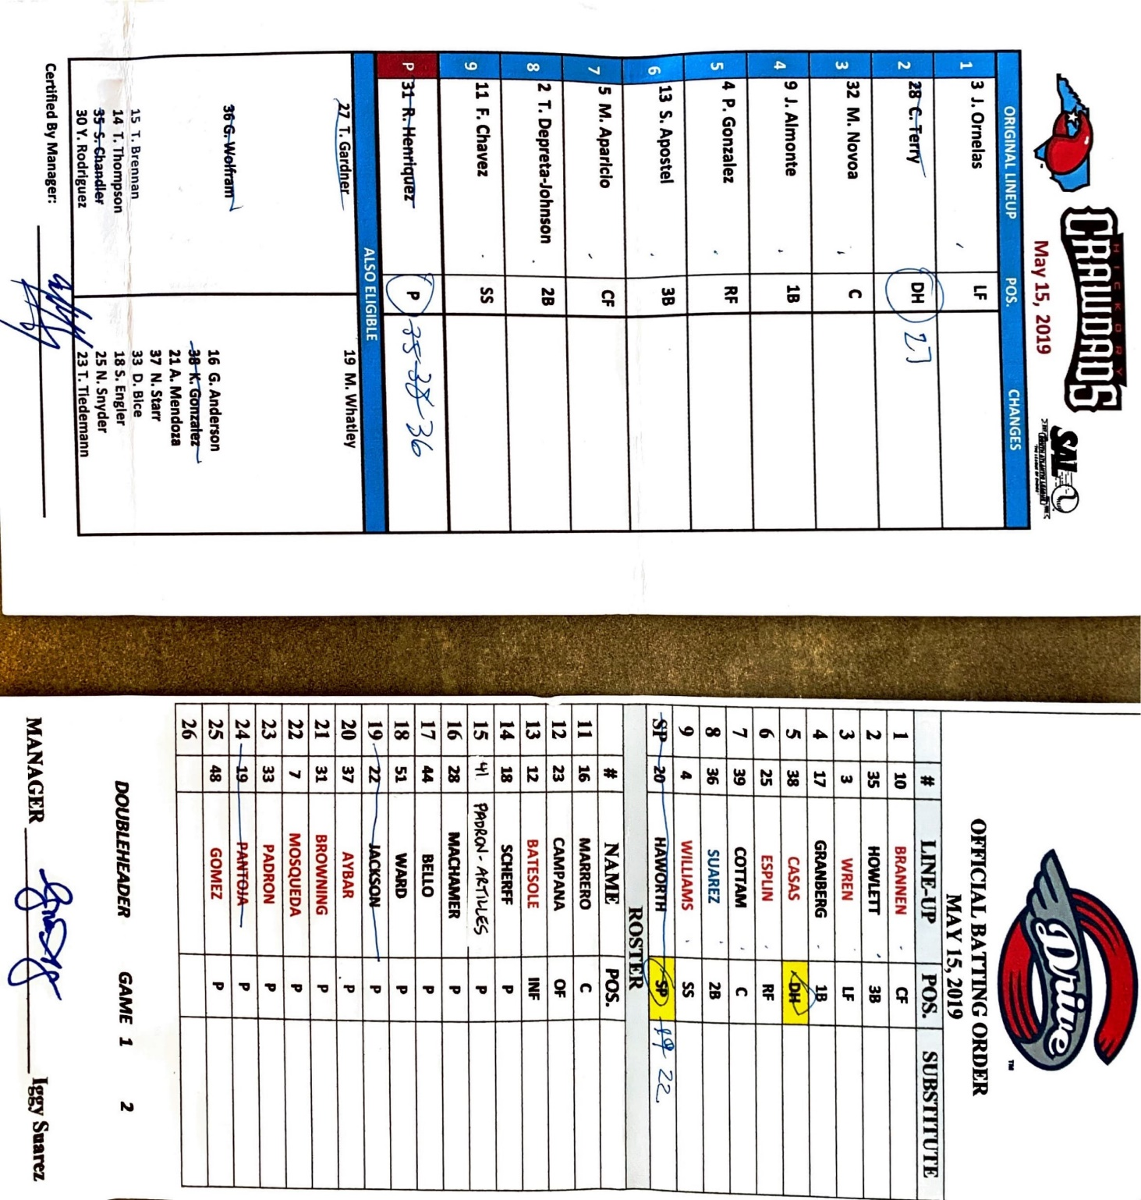

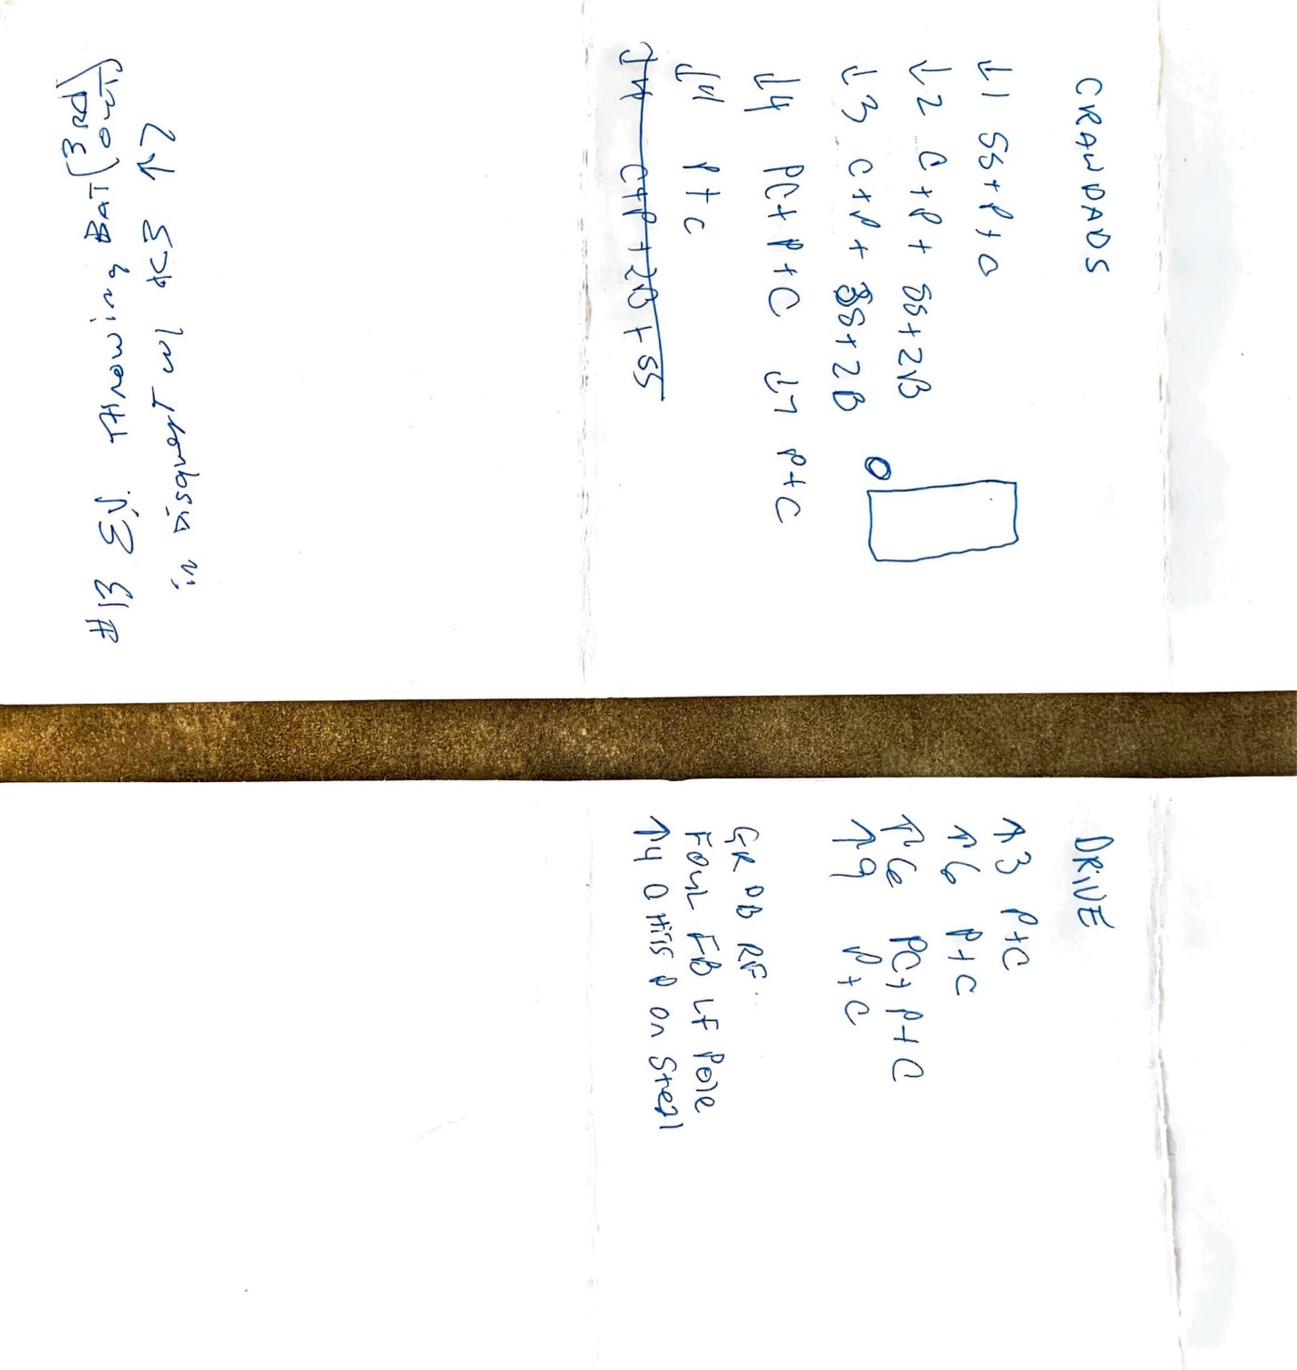
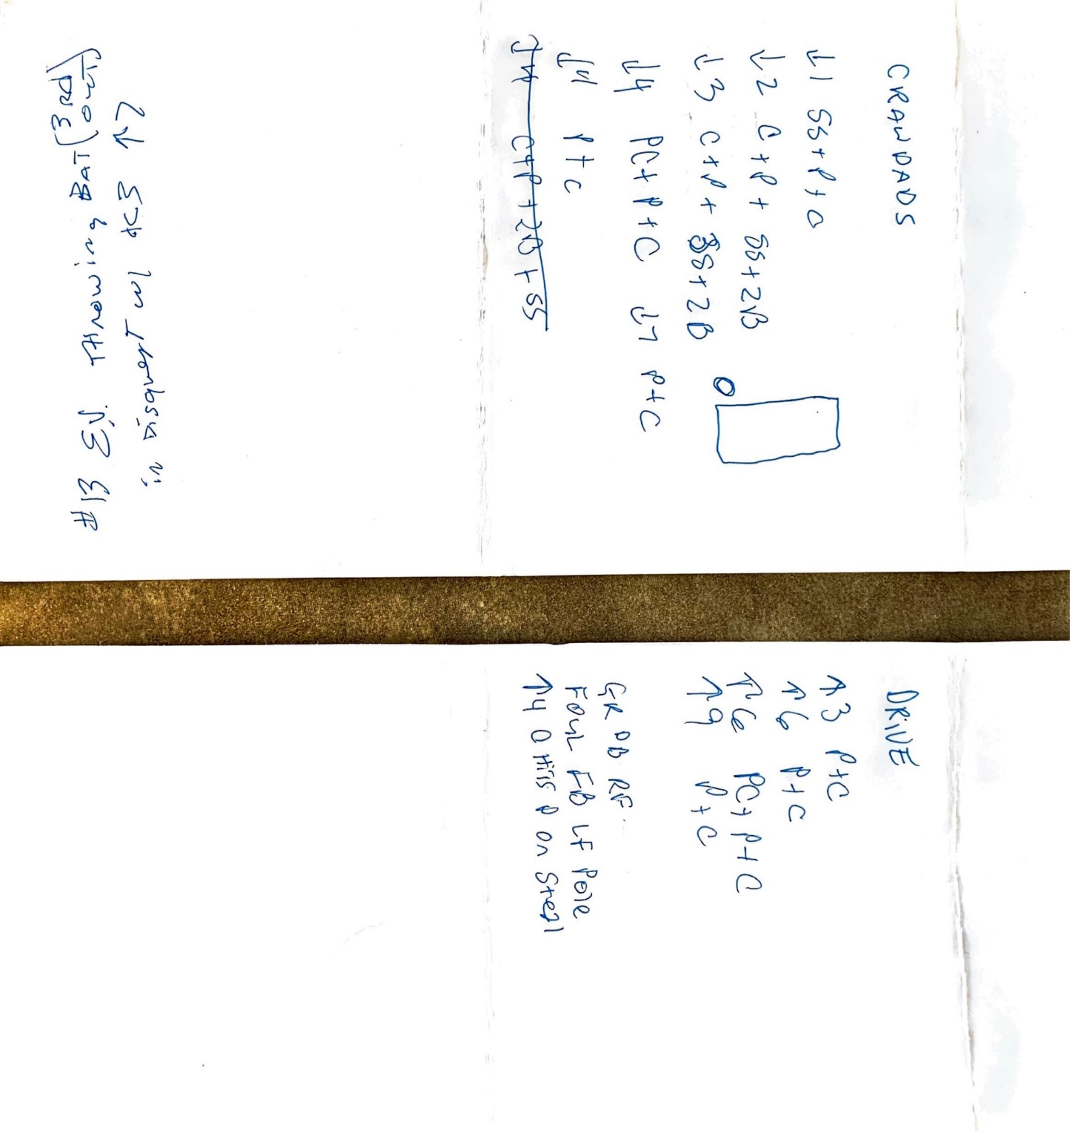

Slide 15
Coaches, Players, Fans will try to steal your confidence with…
Doubt
Insults
compromise
Wear You Down
Work the Umpire
embarrassment
Ex 1 Waving clipboard & yelling while looking directly at you – actions by a team member to intended to ridicule an umpire
Ex 2 Face to face explosive confrontation – refusal to stop arguing after warning her/him
Ex 3 Silent and vulgar – profanity specifically directed at an umpire
Notes:
Discuss some guidelines for Standards For Removal

Slide 16

Activity 1
Think of a moment, unrelated to sports, when you recently exerted confidence to maintain control of a situation.
Write that moment down.

Slide 17
Activity 1: Think of a moment, unrelated to sports, when you recently exerted confidence to maintain control of a situation. Write it down.
Group Share in the chat room
Example: Art room students throwing clay
Next, write down additional words that describe how you felt when you responded.
Notes:
Uninhibited, Free, Instinctual, In Control,
We each have the confidence to be authoritative within us, it needs to cultivated

Slide 18
Activity 1: Reflect
Were you trusting your
Abilities?
Staff?
Knowledge?

Slide 19
Activity 2
Think of the reason(s) holding you back from becoming better at game management.
Write your reason(s) down.

Slide 20
Activity 2: Think of the reason(s) holding you back from becoming better at game management.
Group Share in the chat room
Example Stories: *Returning to SB after umpire school
*Bridal shower, not allowed
Started to recognize there was a shell hindering me
Notes:
Couldn’t yet articulate it, but I knew it was there. Women coaches, male umpire; Male coaches, women umpire
Spring 2016 until 2019 to put it into words and actions, finally became comfortable in my own skin, Bridal Shower / Bachelor Party walking in and feeling weird in the wrong place, not allowed

Slide 21
Activity 2: Reflect
Are there situations, ideas,
moments, memories,
things people have said
that have accumulated around you,
that have built a shell
inhibiting your
game management?

Slide 22
Activity 3
Can you recall an experience when you witnessed a fair fight or an unfair fight like in Wrestling? Or another sport?
Write that experience down.

Slide 23
Activity 3:
Can you recall an experience when you witnessed a fair fight like in wrestling?
Group Share in the chat room
Example Story: Top of the 9th
Shattered the dogma, and began exerting authority
Notes:
Couldn’t yet articulate it, but I knew it was there
Spring 2016 until 2019 to put it into words and actions, finally became comfortable in my own skin – let’s get centered before moving on

Slide 24
Activity 3: Reflect
Are you trying to Fight Fair?
Or
Are you engaging in a Fair Fight?

Slide 25
Activity 3: Reflect
Trying to Fight Fair
Engaging in a Fair Fight
Are you taking it easy on your opponent
Don’t want to appear as a bad sport
Not taking advantage of your opponent
Everyone is uncomfortable
In your shell
Compromised
When is it going to be over?
How many more outs?
Situations are controlling you and the game
No longer in position of authority
Lost control of game
Not allowing anyone to jerk your chain
Head-to-head competition
Hand-to-hand combat / Rules of Engagement
Comfortable in your own skin
True full self is coming through
Confident
Sharp, clear-headed
Brain is firing
Present - every pitch, play, out, inning
In the moment
In control of the game
Notes:
Captain Kirk on Star Trek, obsessed with control of his ship, well being of his ship is the most important thing

Slide 26
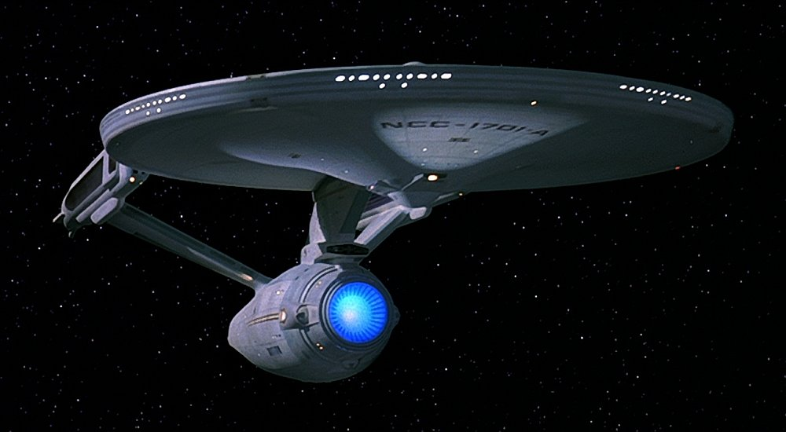
Captain Kirk guided by a sensibility to make decisions to keep control and protect his ship

Slide 27
Activity 3: Reflect
Trying to Fight Fair
Engaging in a Fair Fight
Trying to be nice
Not offending anyone
Taller / Shorter
Bigger / Smaller
Male / Female
Compromise yourself to fit in
No longer caring
Timid, quiet
Negotiate within your own head
Level playing field
Education, Driver’s License, Literacy
Equal Training, Assessment, and Privacy to Shower/Change
Equal pay for equal work, on contract
Medical Benefits / Worker’s Compensation
Assessment & Evaluation during Season
Equal Union Representation
Ability, Experience, Time In
Post Season Selections, Ranking, & Promotions
Performance under pressure
Only good as your next call

Slide 28
Activity 3: Recentering Our Mindset
Trying to Fight Fair
Engaging in a Fair Fight
Trying to be nice
Not offending anyone
Taller / Shorter
Bigger / Smaller
Male / Female
Compromise yourself to fit in
No longer caring
Timid, quiet
Negotiate within your own head
Level playing field
Education, Driver’s License, Literacy
Equal Training, Assessment, and Privacy to Shower/Change
Equal pay for equal work, on contract
Medical Benefits / Worker’s Compensation
Assessment & Evaluation during Season
Equal Union Representation
Ability, Experience, Time In
Post Season Selections, Ranking, & Promotions
Performance under Pressure, no time for anything else
Only Good as Your Next Call (Rules & Judgement)
Notes:
Emails from supervisors and admins, hit in the cup

Slide 29
Examples
Emails from admin
Catcher hit in the cup
“Dear Lady and Gentlemen…”
“Attention Guys and Jen…”
Stay assertive
Don’t walk away
If coach / trainer come out
Stay in there and keep umpiring

Slide 30

Confidence is strengthened through trust in DEEPER ROOTS…
An Official’s Confidence
Rules Knowledge
Crew & Staff
Your Ability
1st Impressions
Fitness
Nutrition
Hydration
Recovery
Teamwork
Communication
Pressure Make Diamonds
Well Written
Uniform
Personality
Plate / Base
Difficult Situations
Signals/Voice
Flexible but Firm
Journaling
Paperwork
Jumbotron
Routine/Surprise
Big Games
Expressions
History
Guidelines
Warnings
Removal
Longevity
Have Class

Slide 31

An Official’s Confidence
Rules Knowledge
Crew & Staff
Your Ability
1st Impressions
Fitness
Nutrition
Hydration
Recovery
Teamwork
Communication
Pressure Make Diamonds
Well Written
Uniform
Personality
Plate / Base
Difficult Situations
Signals/Voice
Flexible but Firm
Journaling
Paperwork
Jumbotron
Routine/Surprise
Every Game Is A Big Game
Expressions
History
Guidelines
Warnings
Removal
Longevity
Have Class

Slide 32


In Closing
  Protect your Confidence!
  When fatigue sets in during the last few reps, those are the ones that matter most!
  When players and coaches try to steal our confidence
  we must dig deeper and rely on our roots
  to maintain control and keep making good decisions!
  Keep officiating ☺

Slide 33


Thank you!
Contact Jen Pawol
evolve2excellence@gmail.com
www.evolve2excellence.com

