Slide 1
UMPIRING: more then rules and mechanics
Communication

Slide 2

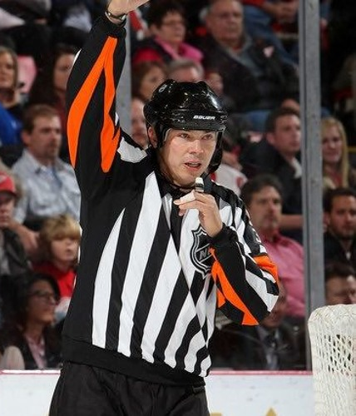
my background
Born and raised in Vernon BC
Started officiating at 13
Worked through junior and whl
Four years as NHL trainee
1998 hired by Nhl
Worked 20 years
2 years as whl officiating coach
Currently bet at home ice hockey league officiating coach I austria

Slide 3
Most important traits in officials
Judgement
Communication
Personality
Physical skill set

Slide 4
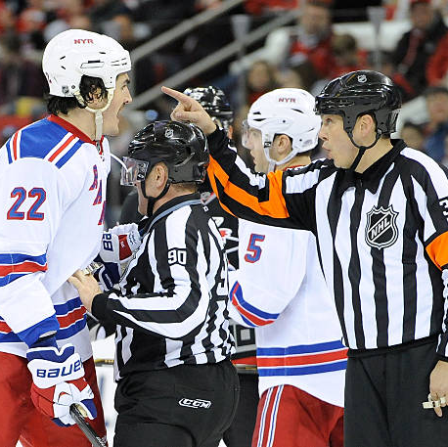
what IS OUR GOAL IN COMMUNICATING?

Slide 5

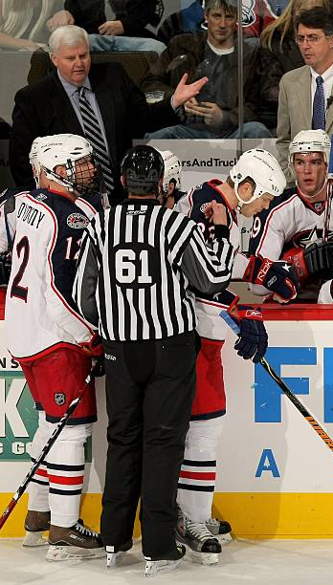
CREATE an environment so when times get tough, we can work together to get through them
In life or in a game, communication is the key to getting through hard times

Slide 6
Why do we communicate?
Our Goals
Build
Build Rapport
open dialogue
Create
Create Respect
For Both you and your teammates
Humanize
Humanize Us
FAMILY, WORK, HIGHS AND LOWS OF LIFE
Foster
Foster an environment so when times get tough, we can get through it with the respect we have earned AND CREATED.

Slide 7


HOCKEY VS BALL
OUR START WAS THEir FINISH
  MLB umpires are good people
SAME PEOPLE, SAME ISSUES
  Issues the umpires had were same issues as referees
WE ALL WANT THE BEST FOR THE GAME
COMMUNICATION IS KEY FOR ALL SPORTS
  acceptance

Slide 8
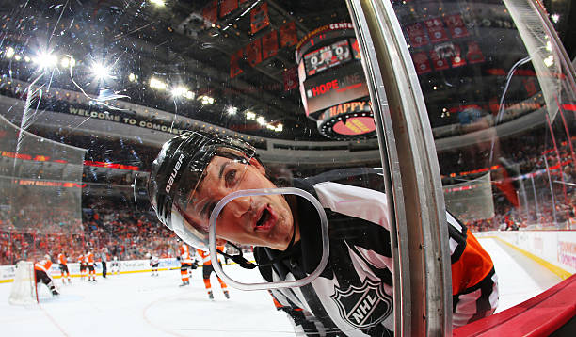
HOW DO WE COMMUNICATE ?

Slide 9
4 types of communication
1. verbal
2. non-verbal
3. listening
4. visual communication

Slide 10
verbal
Words we use
Do they fit the audience?
Tone we use
Aggressive
Calming
Pitch
volume

Slide 11



Non-verbal is 93 percent of communication.
Facial Expressions – Did our face betray us?
Eye Contact – Shows active listening and paying
Attention and shows confidence.
Posture – Does it escalate the situation?
Hand Movement – Can be very calming.

Slide 12
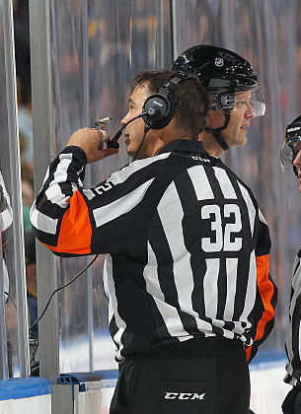
Listening
Art of listening
  Active listening
Why we listen
  Wants and needs

Slide 13
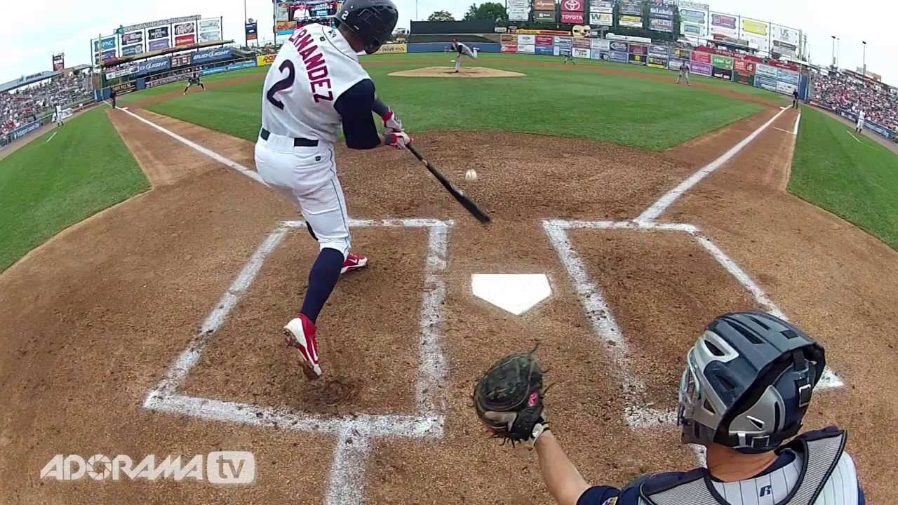
Visual communication
Video review
Watch our games after for learning tool
Not a regular tool used in our tool box at most levels

Slide 14
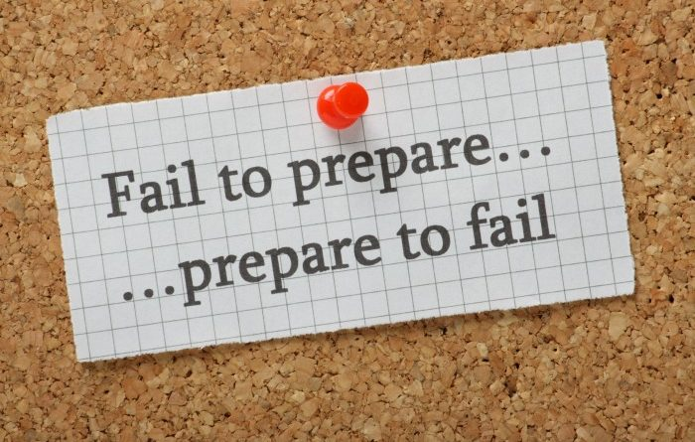
BE PREPARED
DOING YOUR HOME WORK
  KNOWING NAMES & Personalities
  WHAT YOUR GOING TO SAY BEFORE YOU HAVE TO SAY IT.

Slide 15
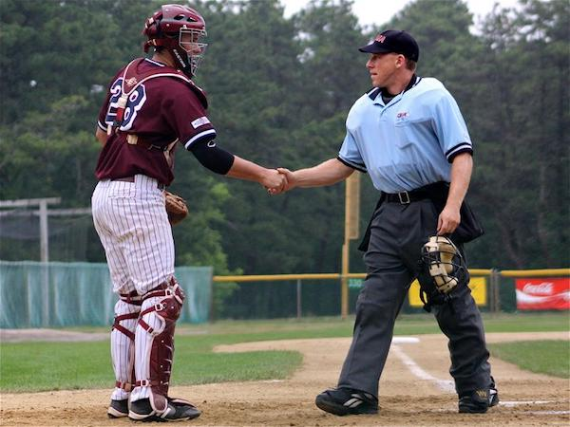
Built in communication
Opportunities created within the game
  BUMP ON THE GOALIE
  OPENING FACE OFF
  By the bench on a stoppage

Slide 16
Manufactured opportunities
Creating opportunities to communicate
  FIRST LINE CHANGE
  NEW PLAYER IN THE LEAGUE
  A PLAY FROM THE GAME BEFORE

Slide 17
Deescalating situations VS ESCALATING SITUATIONS
Empathy
Understanding
Body language
Words

Slide 18
Humanizing
Sincere
Over time people see thru “fake”
Not afraid to admit our flaws and mistakes
Stand up for ourselves and our team

Slide 19
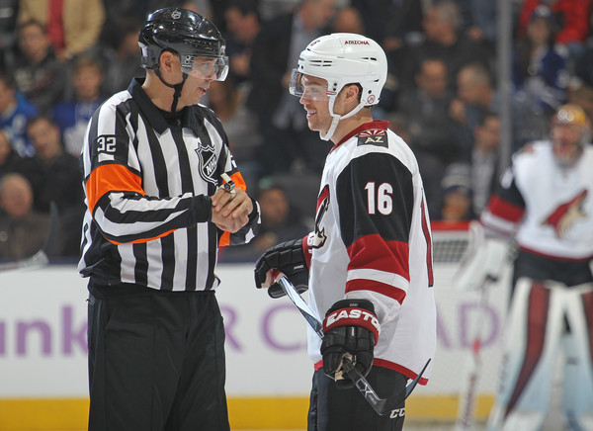
Don’t be afraid to smile
End of the day this is a game and fun
should be had by all participants

Slide 20

Questions

Slide 21
Thank you for having me
Great day to play two.

